Slide 1
Shqiperia (Albania) Land of the Eagle

Slide 2
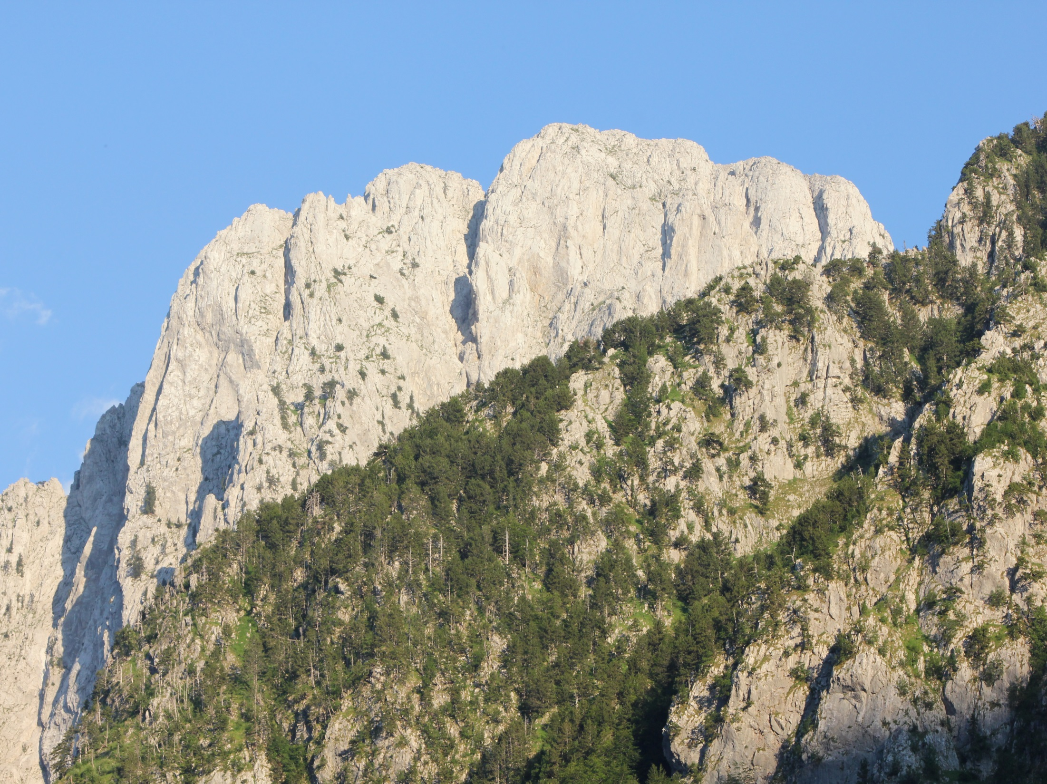
Steve’s 2015 Trip

Slide 3
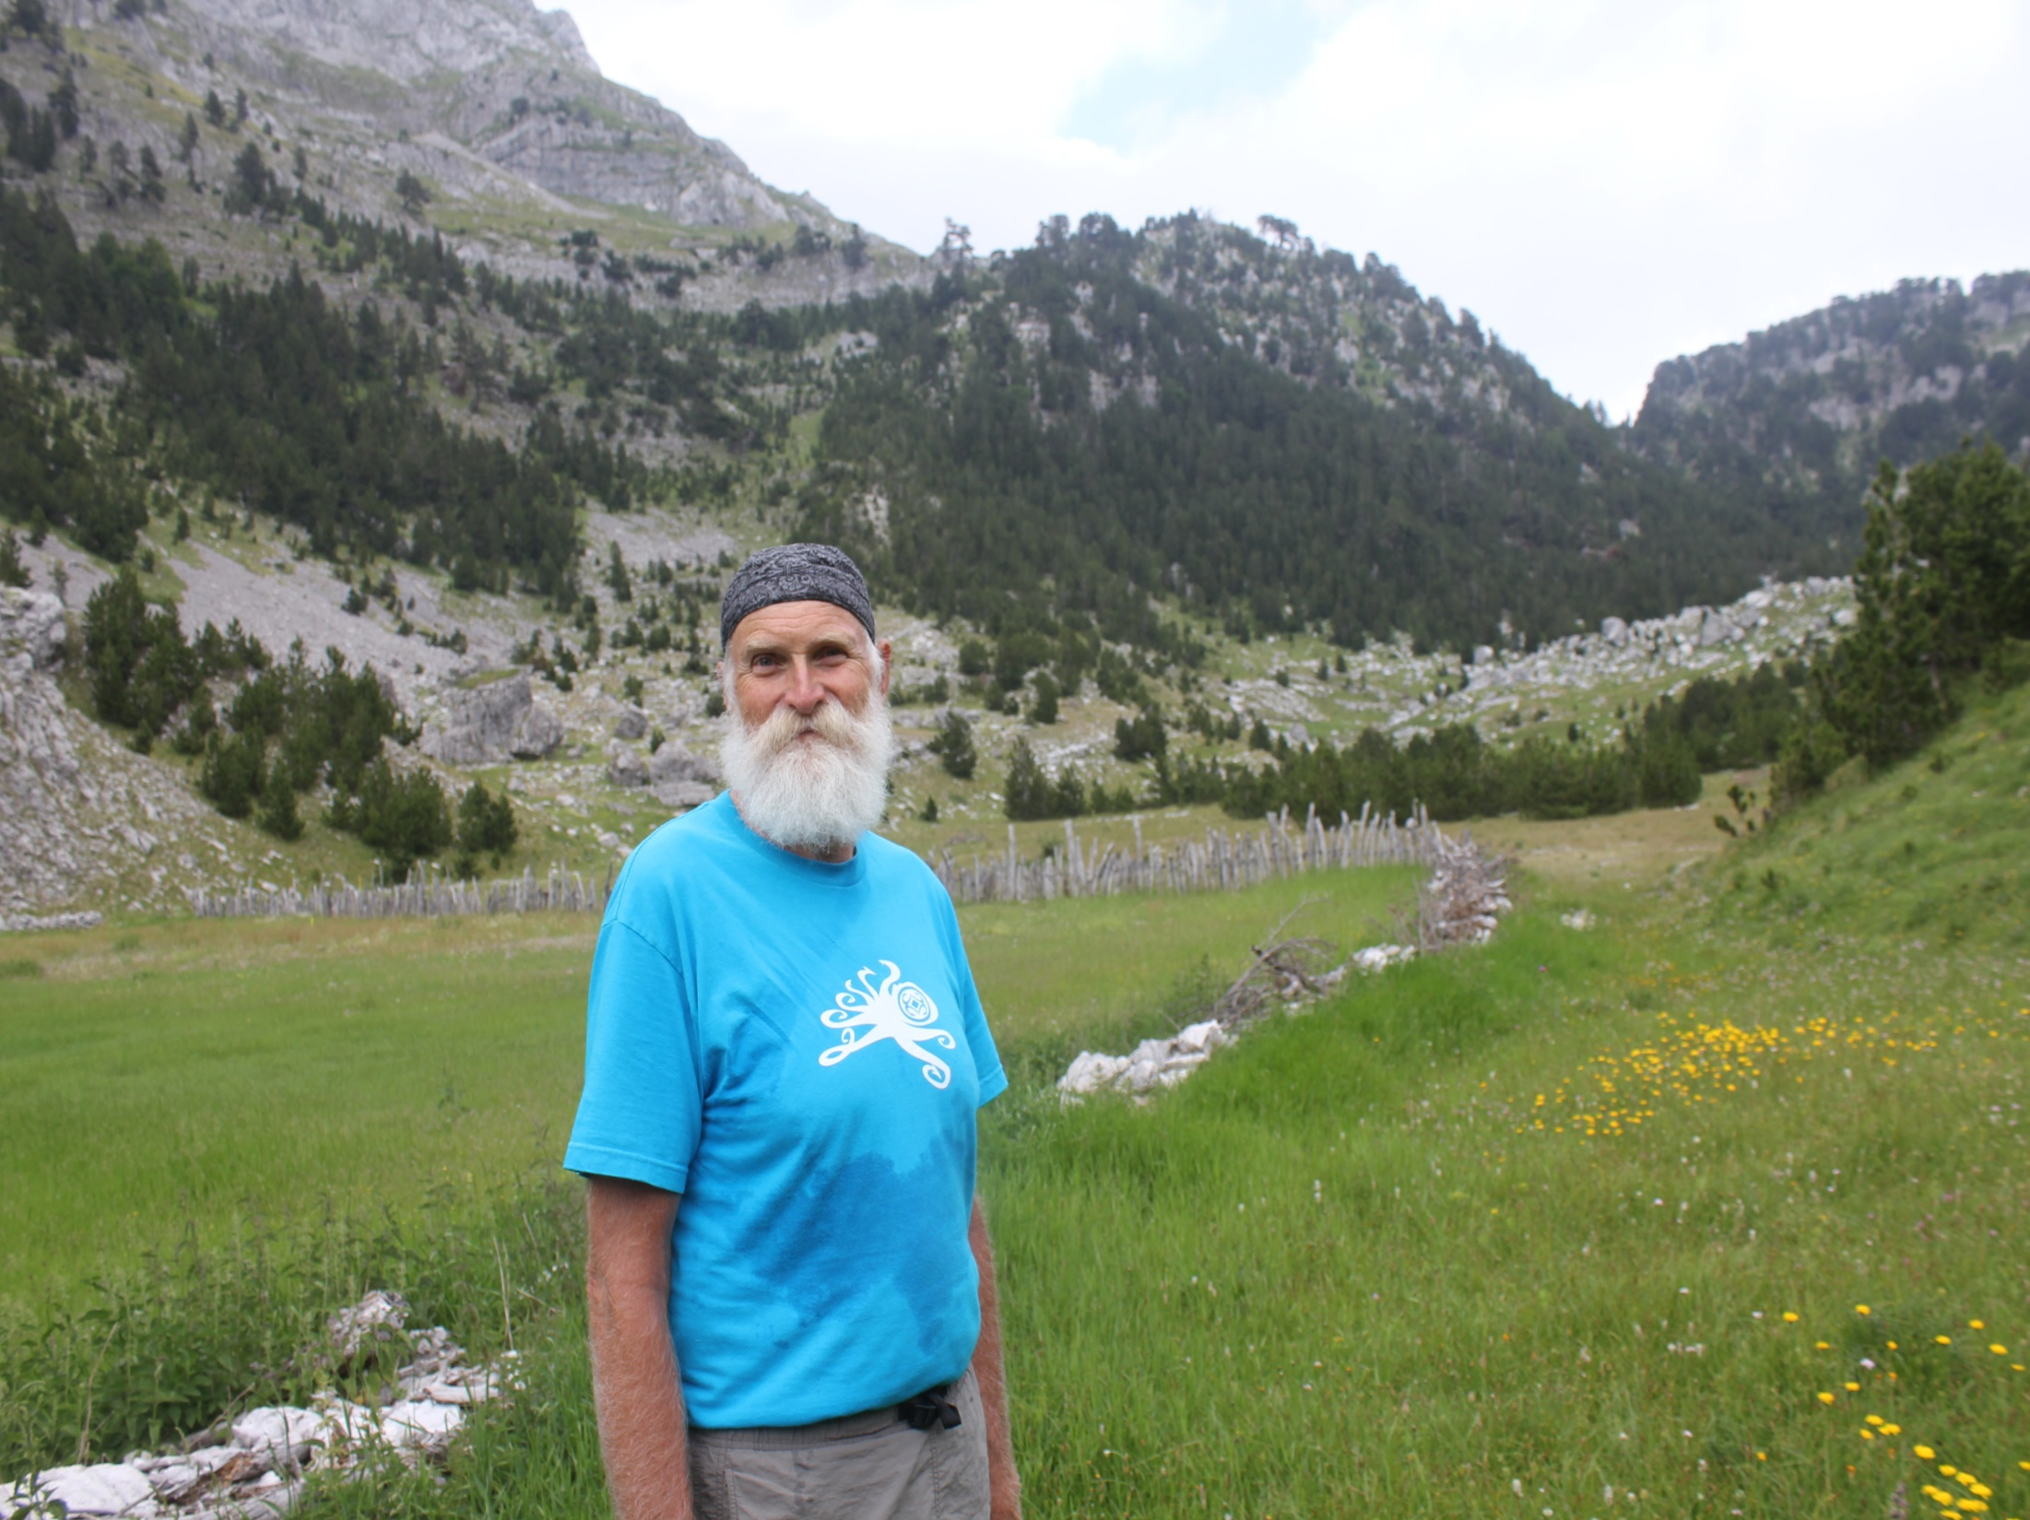
Trekking to Stegu
Dhenve (Goat Pass)

Slide 4
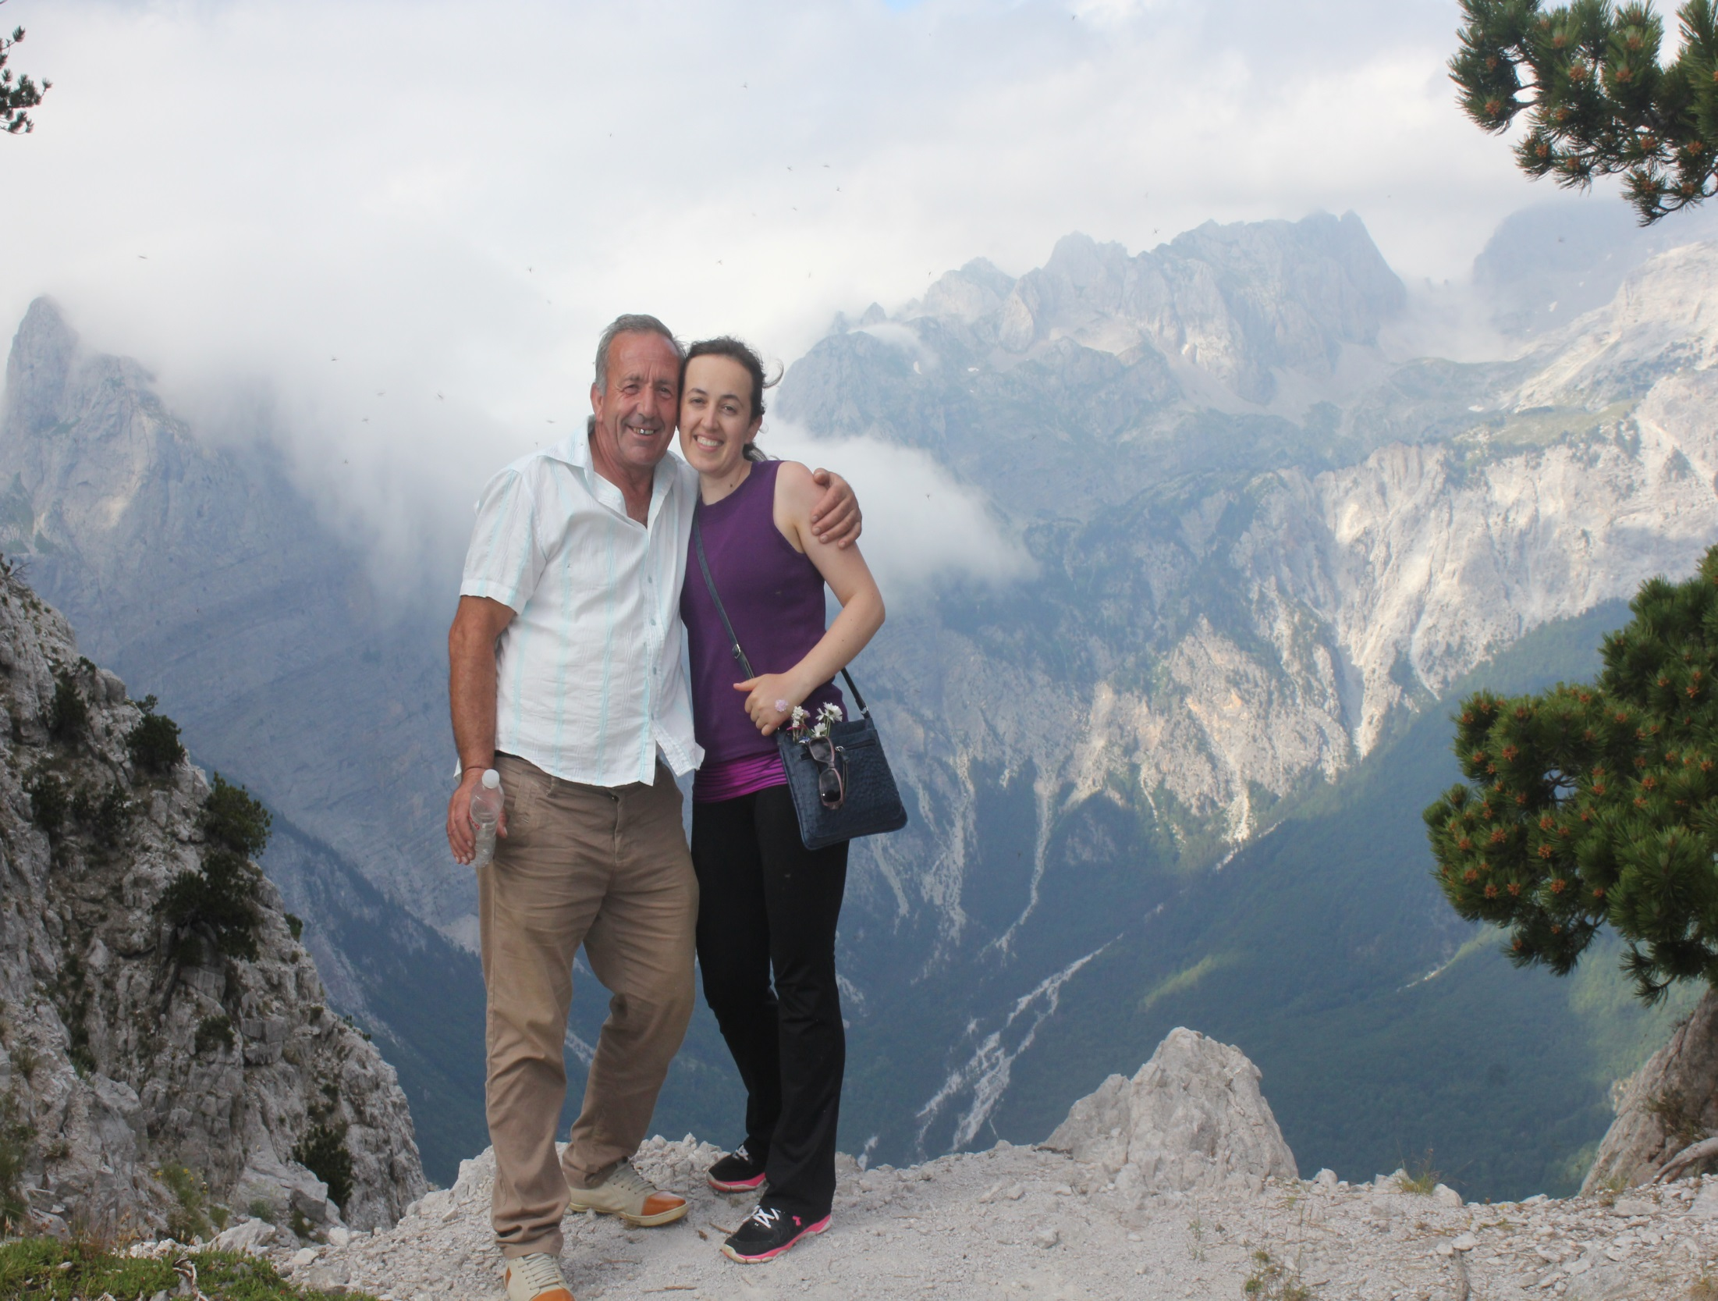
AAI board member, Kristina Milaj
& Uncle Ndue Milaj in Stegu Dhenve

Slide 5
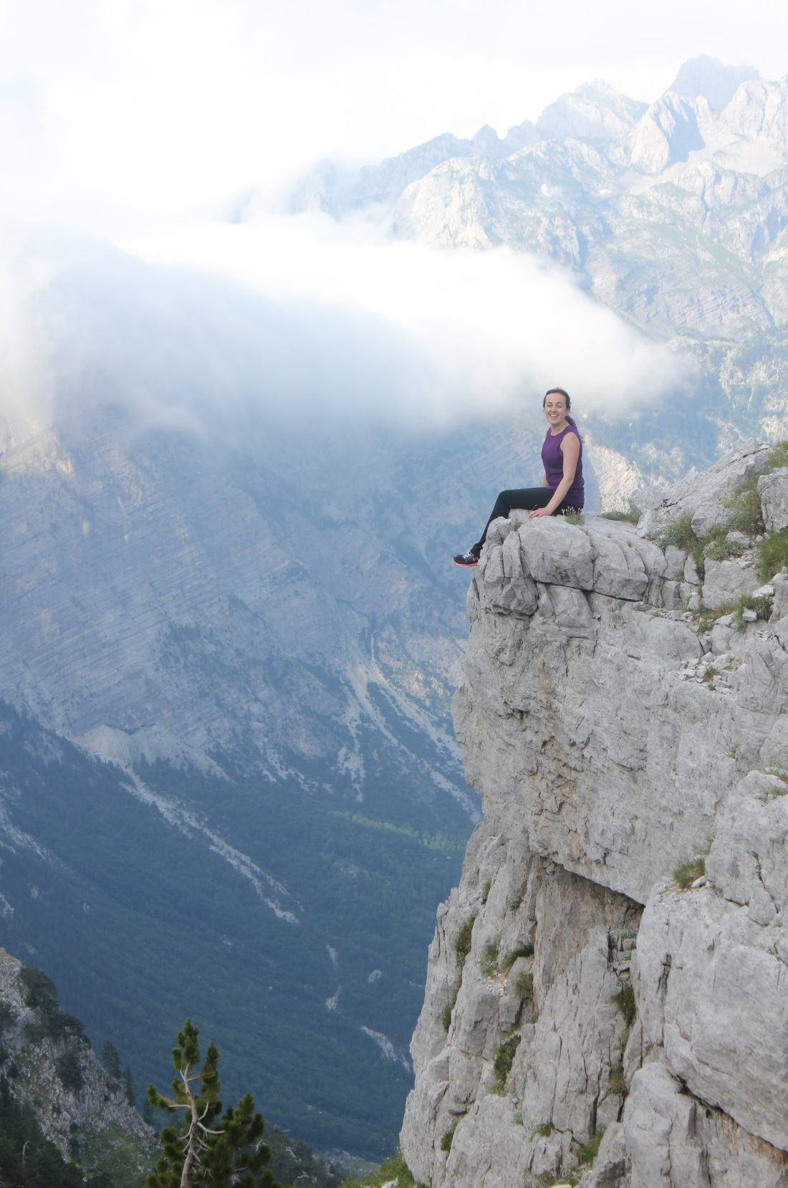
Kristina above
Stegu Dhenve

Slide 6
Dielle Rakaj, 89,
Boga, Knitting

Slide 7
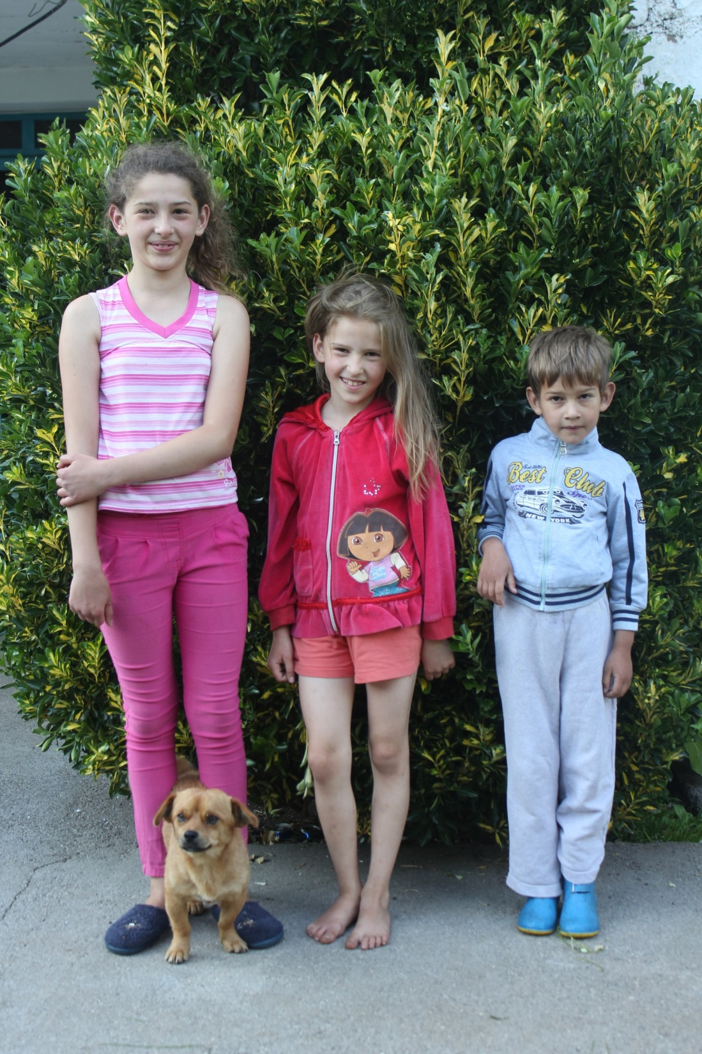
Boga Teacher, Ardian Ulaj’s kids, Vana, Juli, Marceli

Slide 8
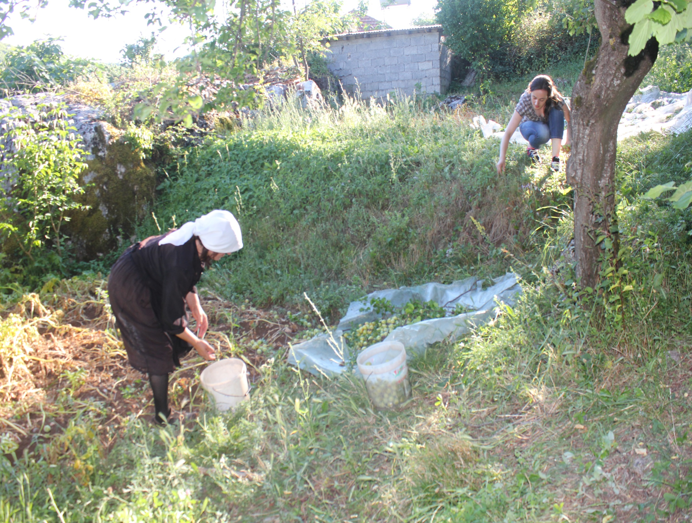
Kristina and mother Violeta
gathering plums for Raki (brandy)

Slide 9
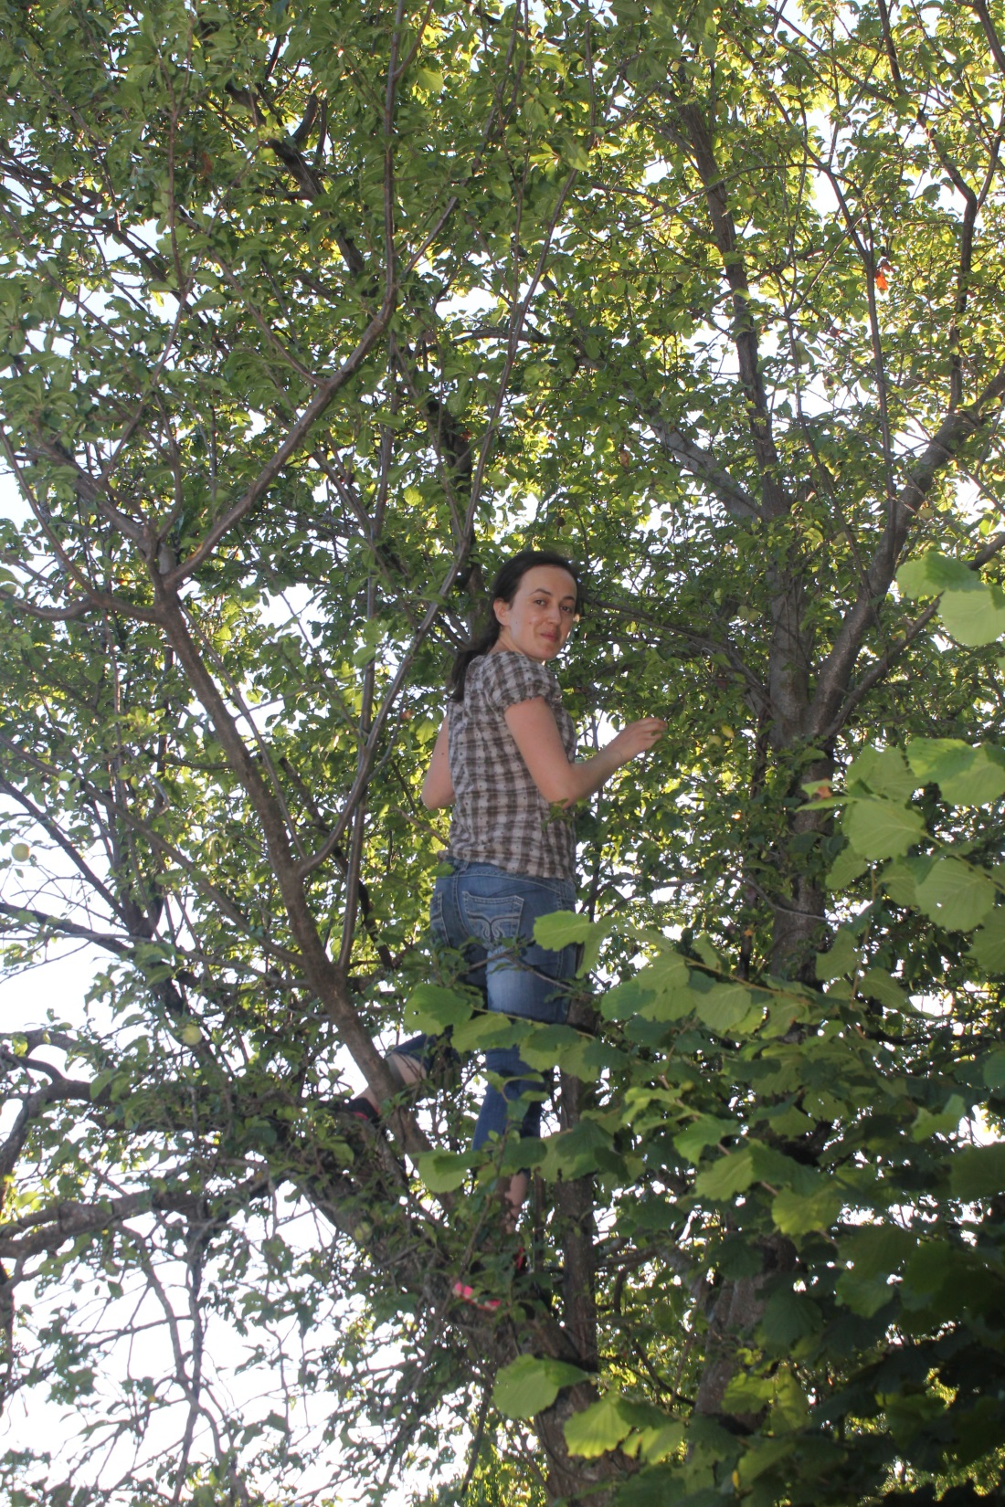
Kristina in the plum tree

Slide 10
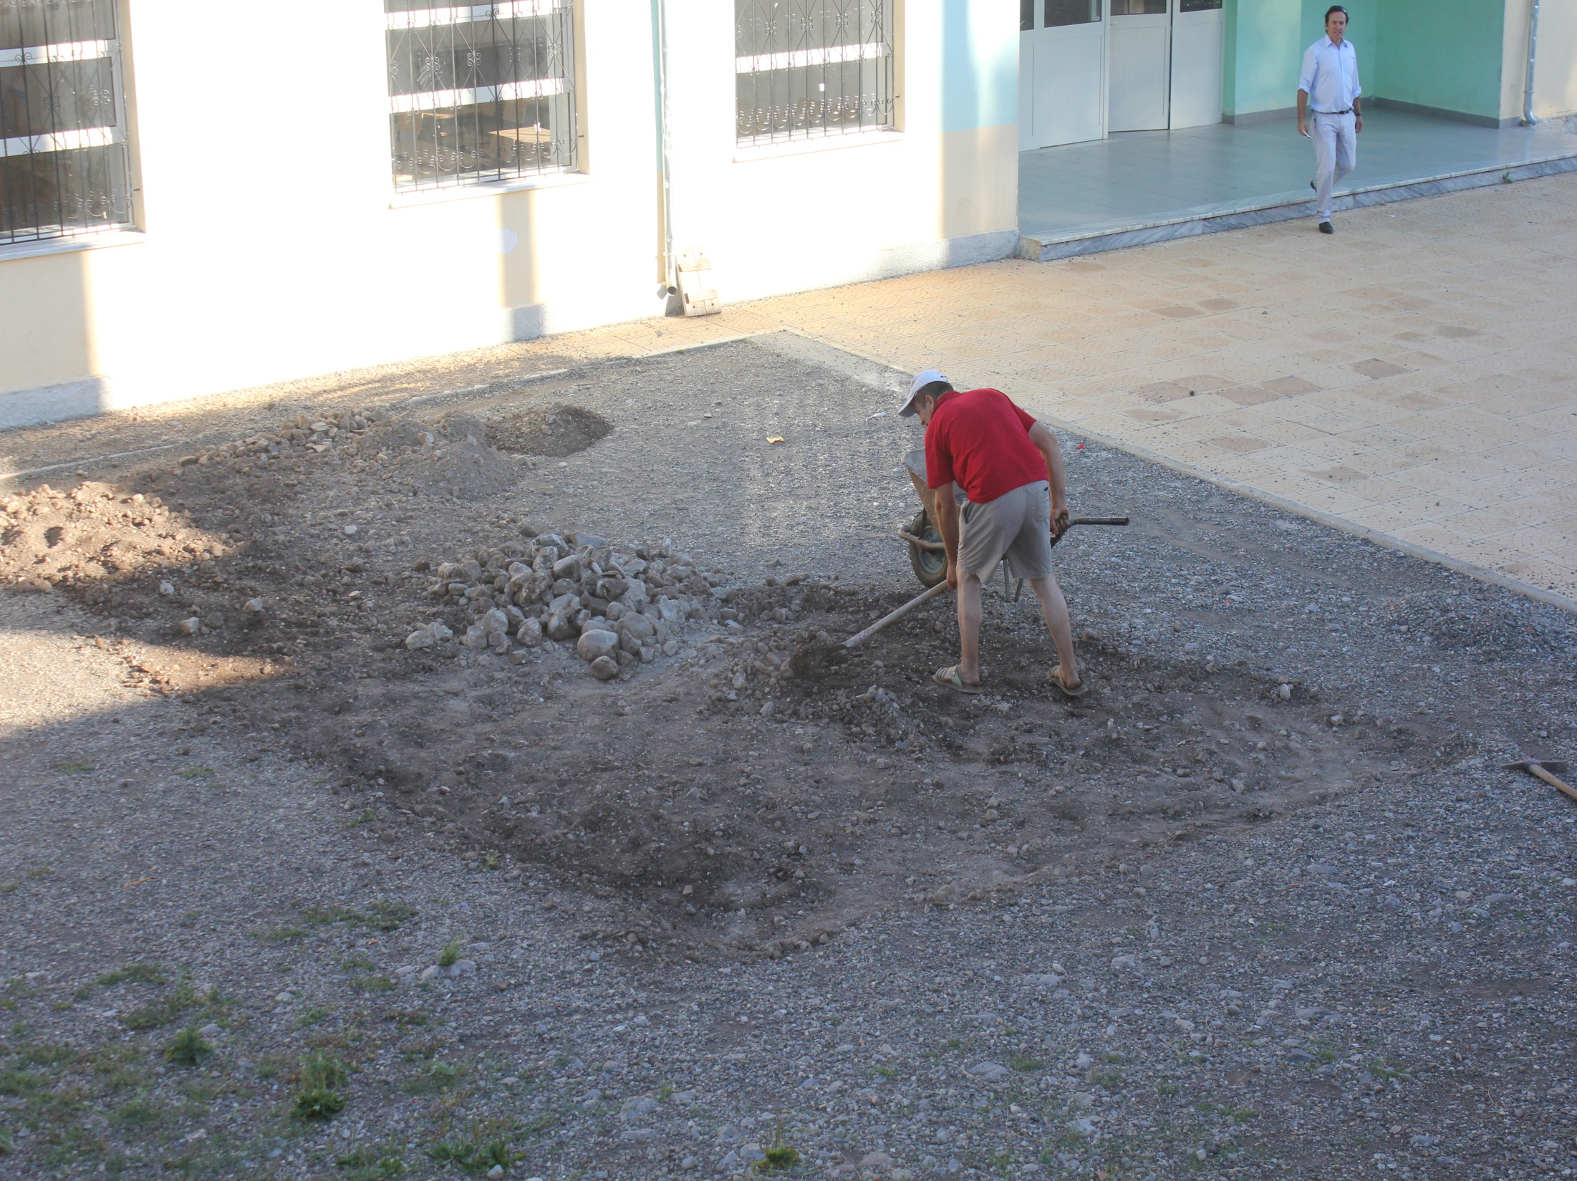
AAI English Teacher, Aleks Vulaj
excavating for new playground
equipment in Vrithe. School
Director Gac Purashaj in back.

Slide 11
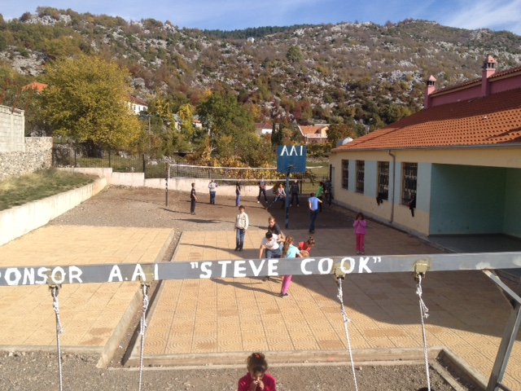
Upgraded play yard at Vrithe School

Slide 12
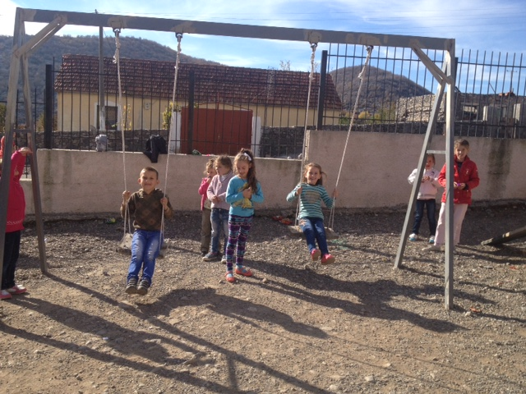
AAI furnished swings

Slide 13
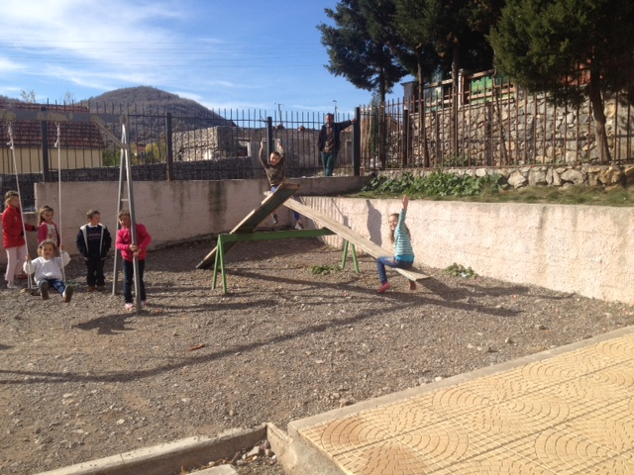
AAI funded teeter
totters

Slide 14
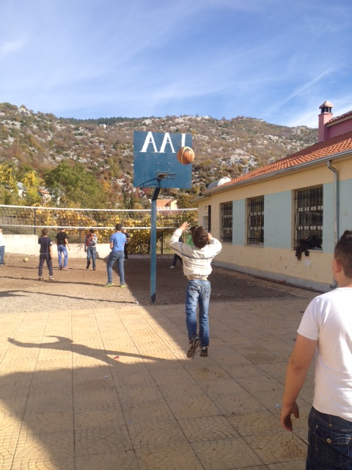
AAI funded
new basket-
ball hoop

Slide 15
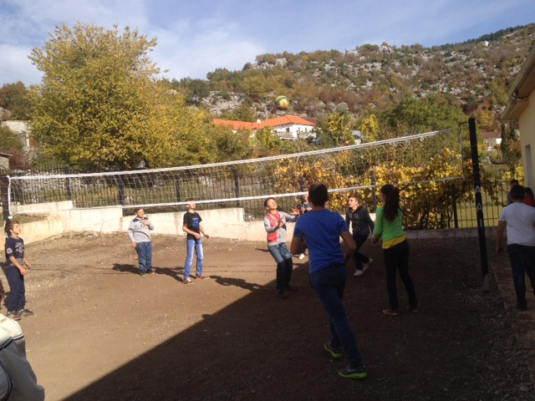
New AAI funded Volleyball Court

Slide 16
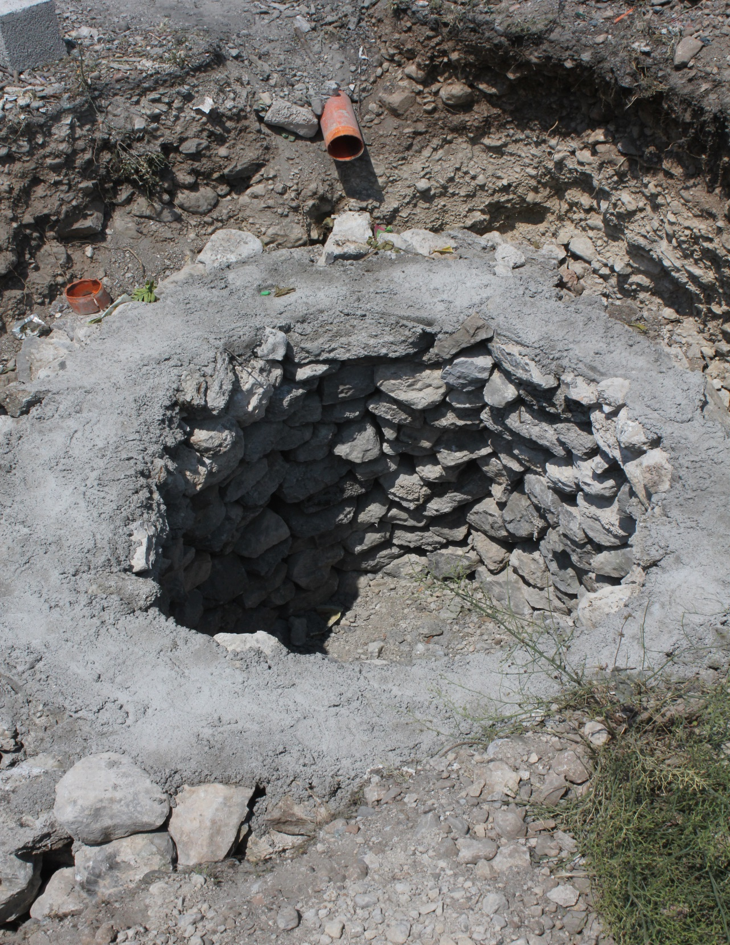
New Septic Pit for Xhaj
School Toilet Project

Slide 17
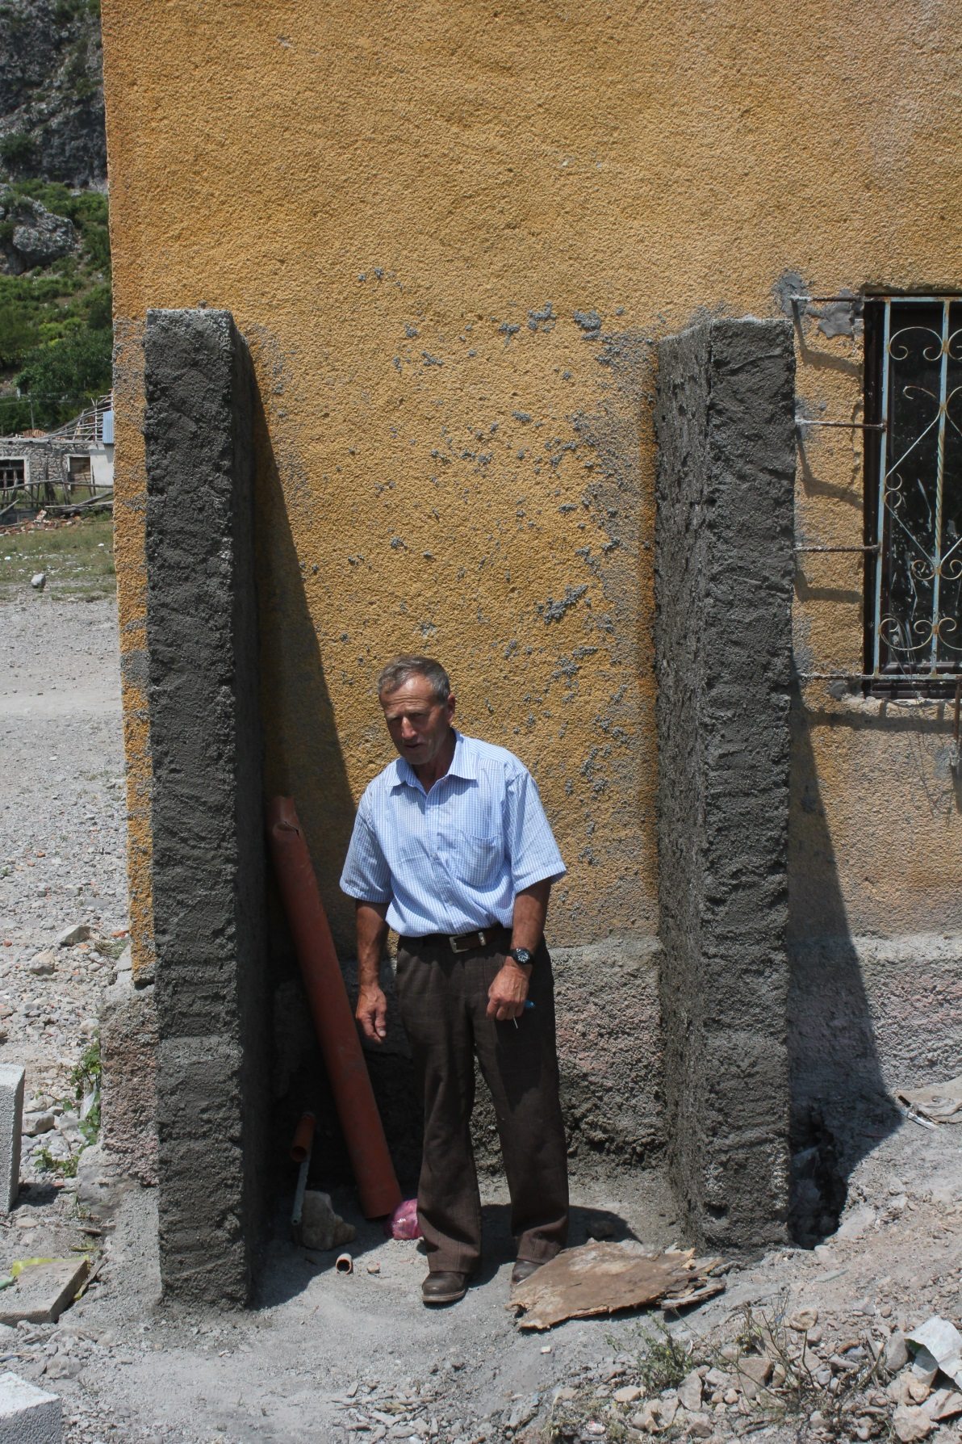
Toma Durgaj constructing
support for water tank

Slide 18
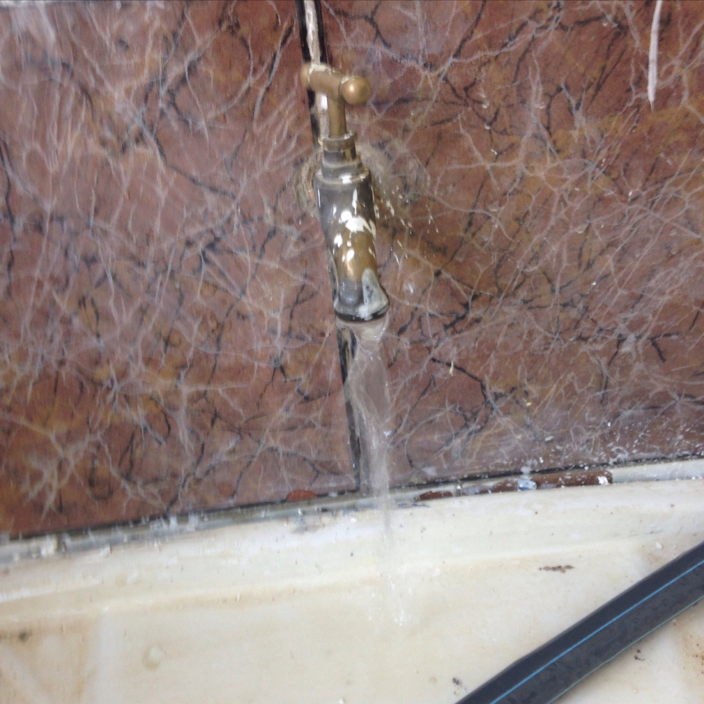
First tap water from Xhaj bathroom in 10 years.
Thanks to
Kristina Milaj’s
group funding
effort, over
$700.

Slide 19
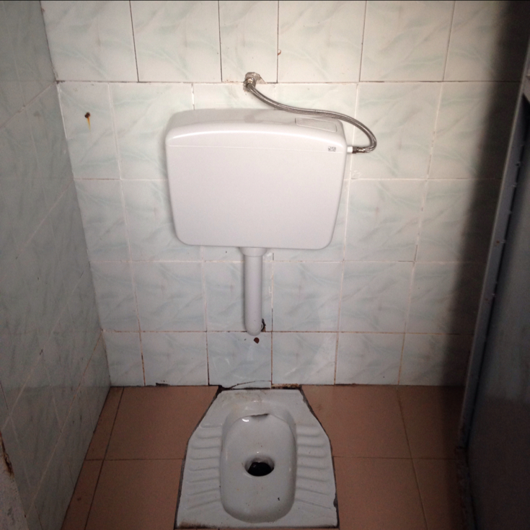
Rebuilt toilet
stall.

Slide 20
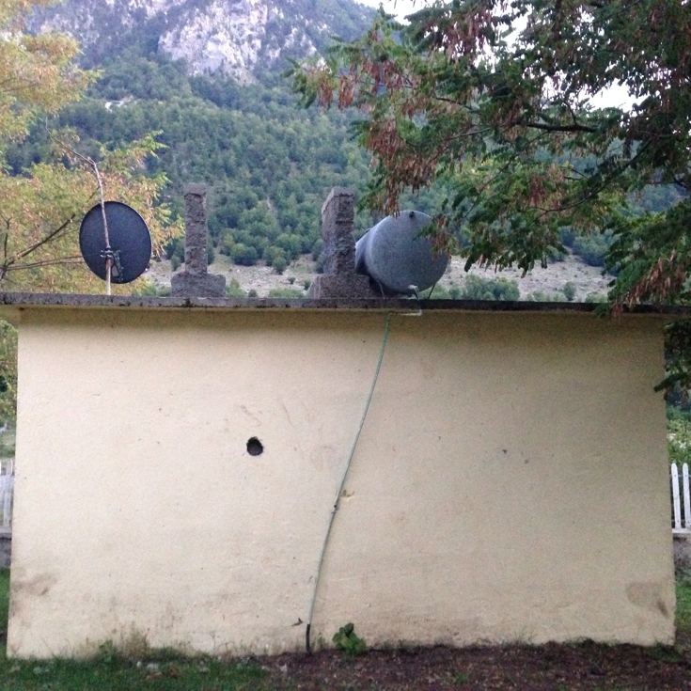
Refurbished
Boga Toilets,
showing
new tank

Slide 21
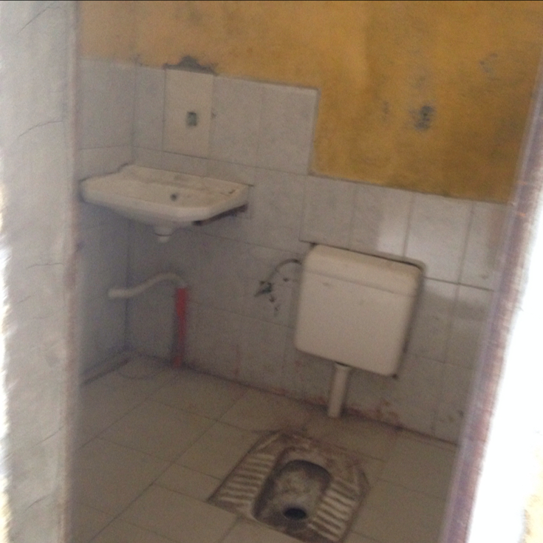
Refurbished
toilet

Slide 22
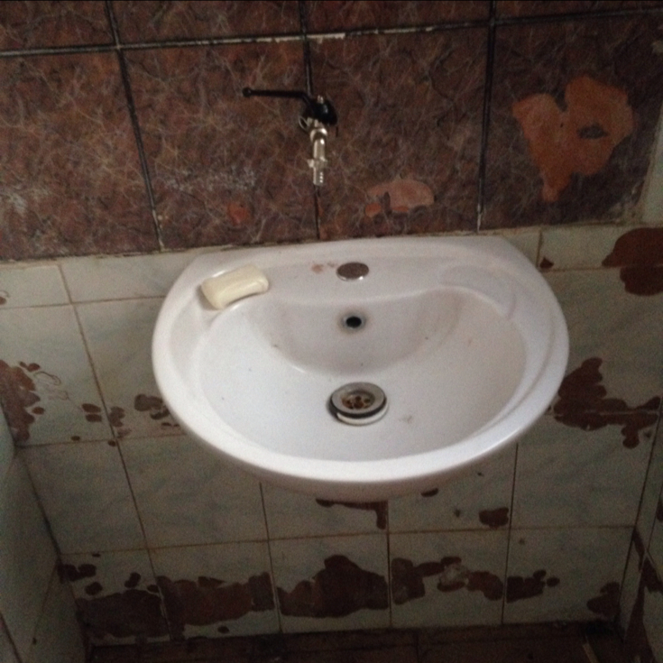
And sink—
note soap

Slide 23
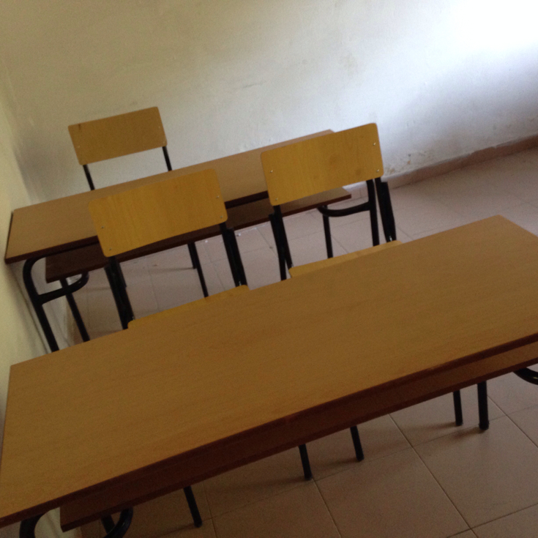
New Boga
desks, thanks
to Anila
Pekmezi, new
School Director

Slide 24
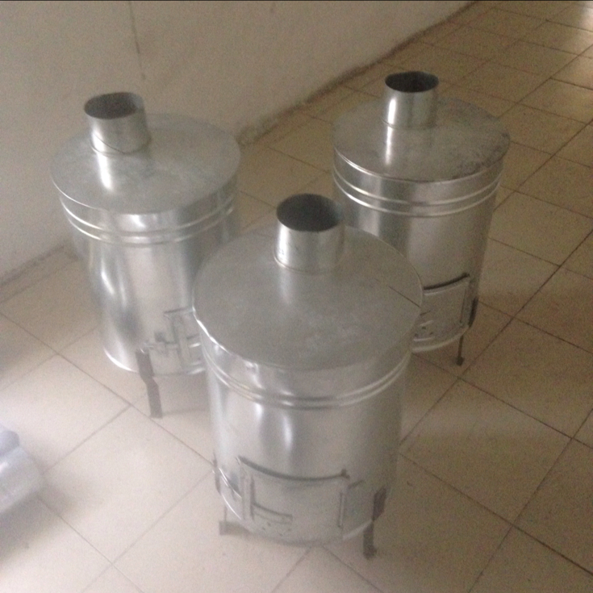
New Boga
classroom
stoves, thanks
to AAI funds.

Slide 25
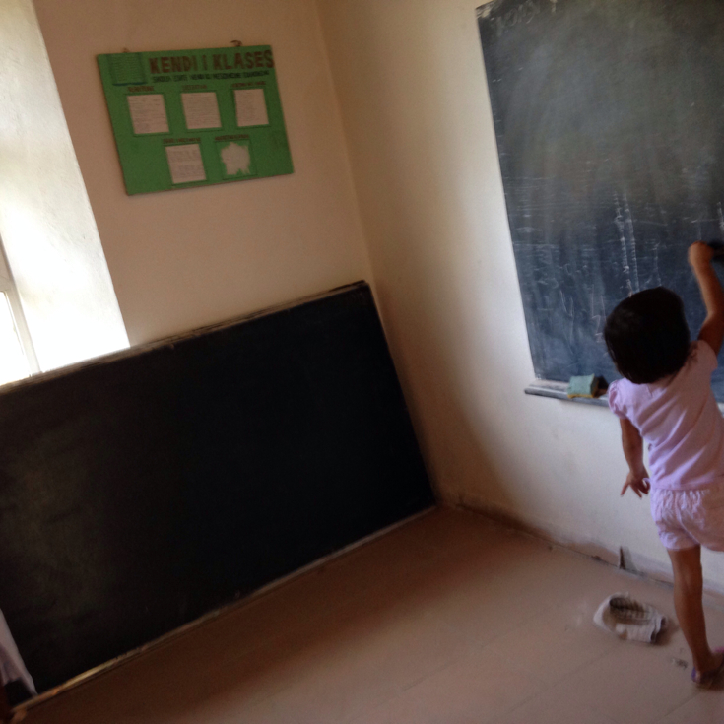
New Boga
blackboard
funded by AAI

Slide 26
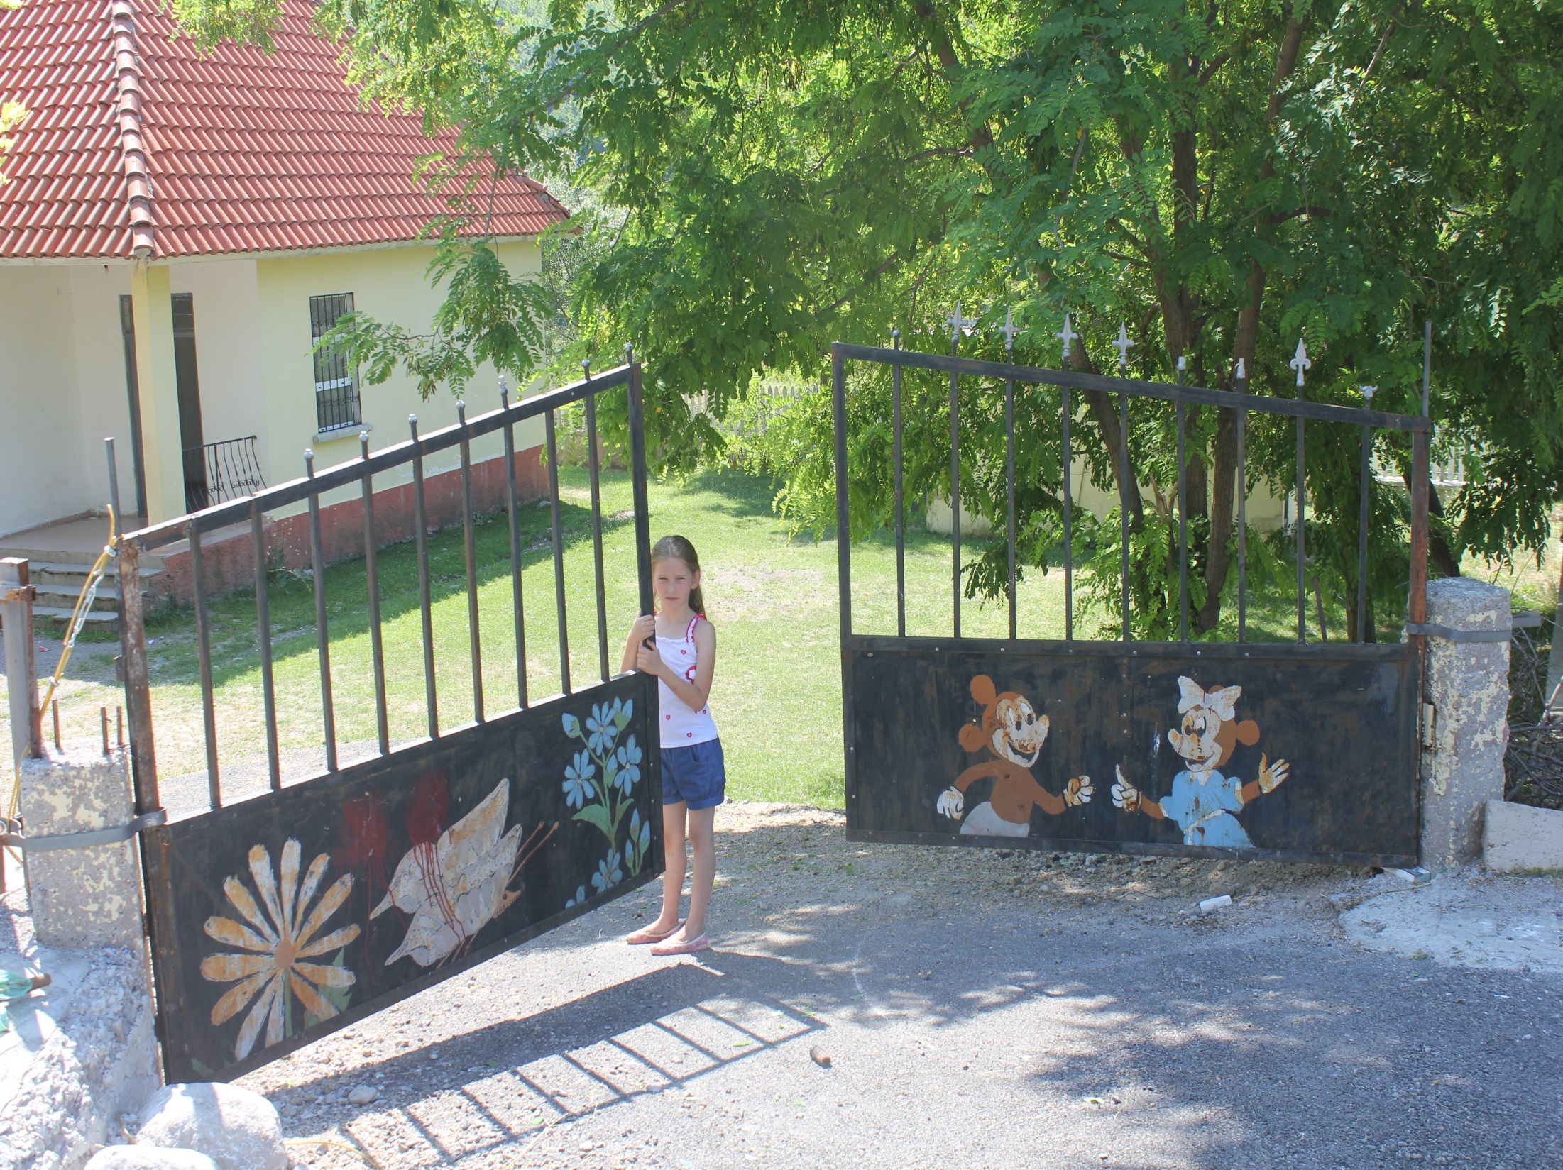
Juli Ulaj and Boga school
gate repaired yet again
by Steve

Slide 27
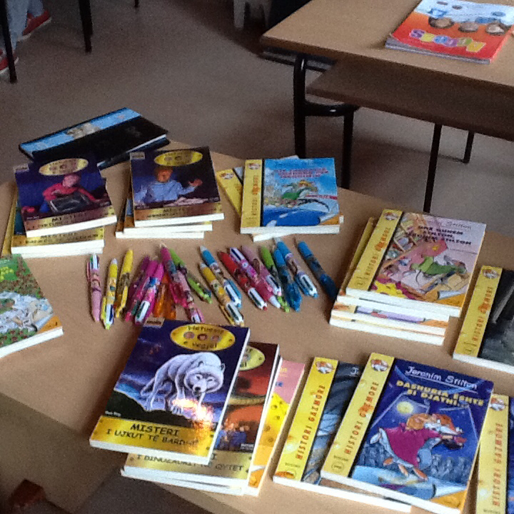
AAI funded
kindergarten
supplies for
Xhaj school.

Slide 28
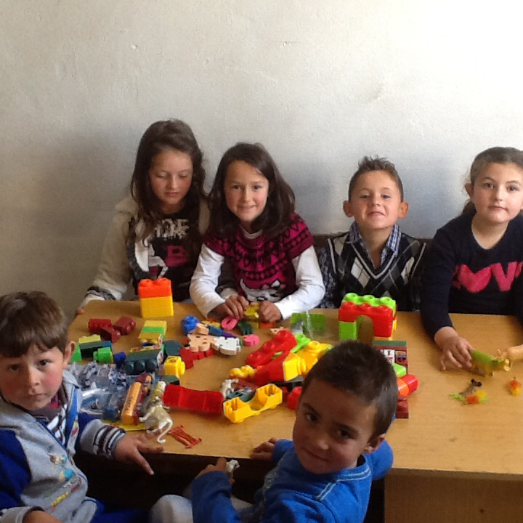

Slide 29
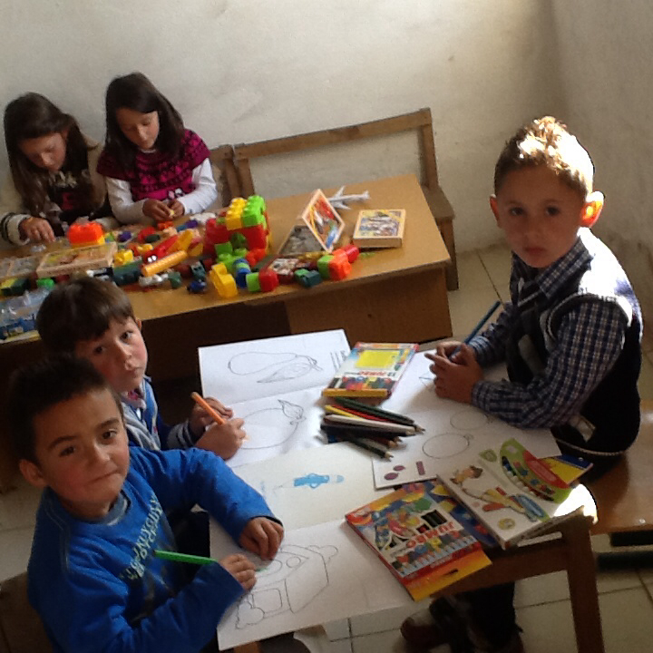

Slide 30
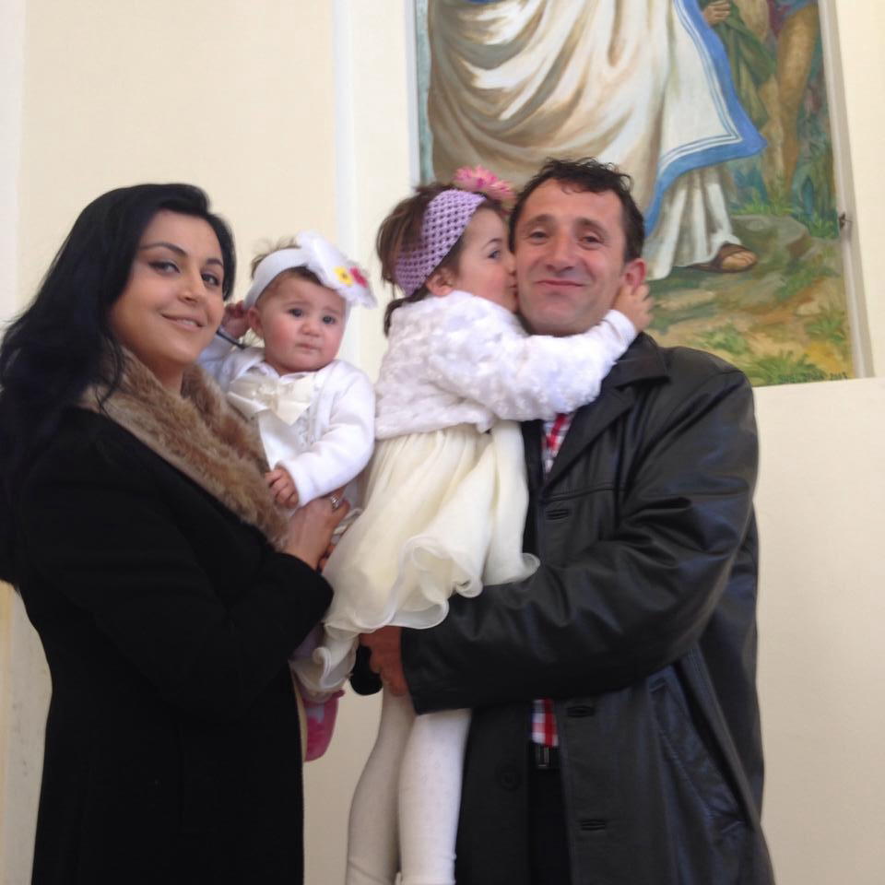
Xhaj and Boga School Director
Anila Pekmezi, with husband
Alex and daughters Anabel and
Alessia

Slide 31
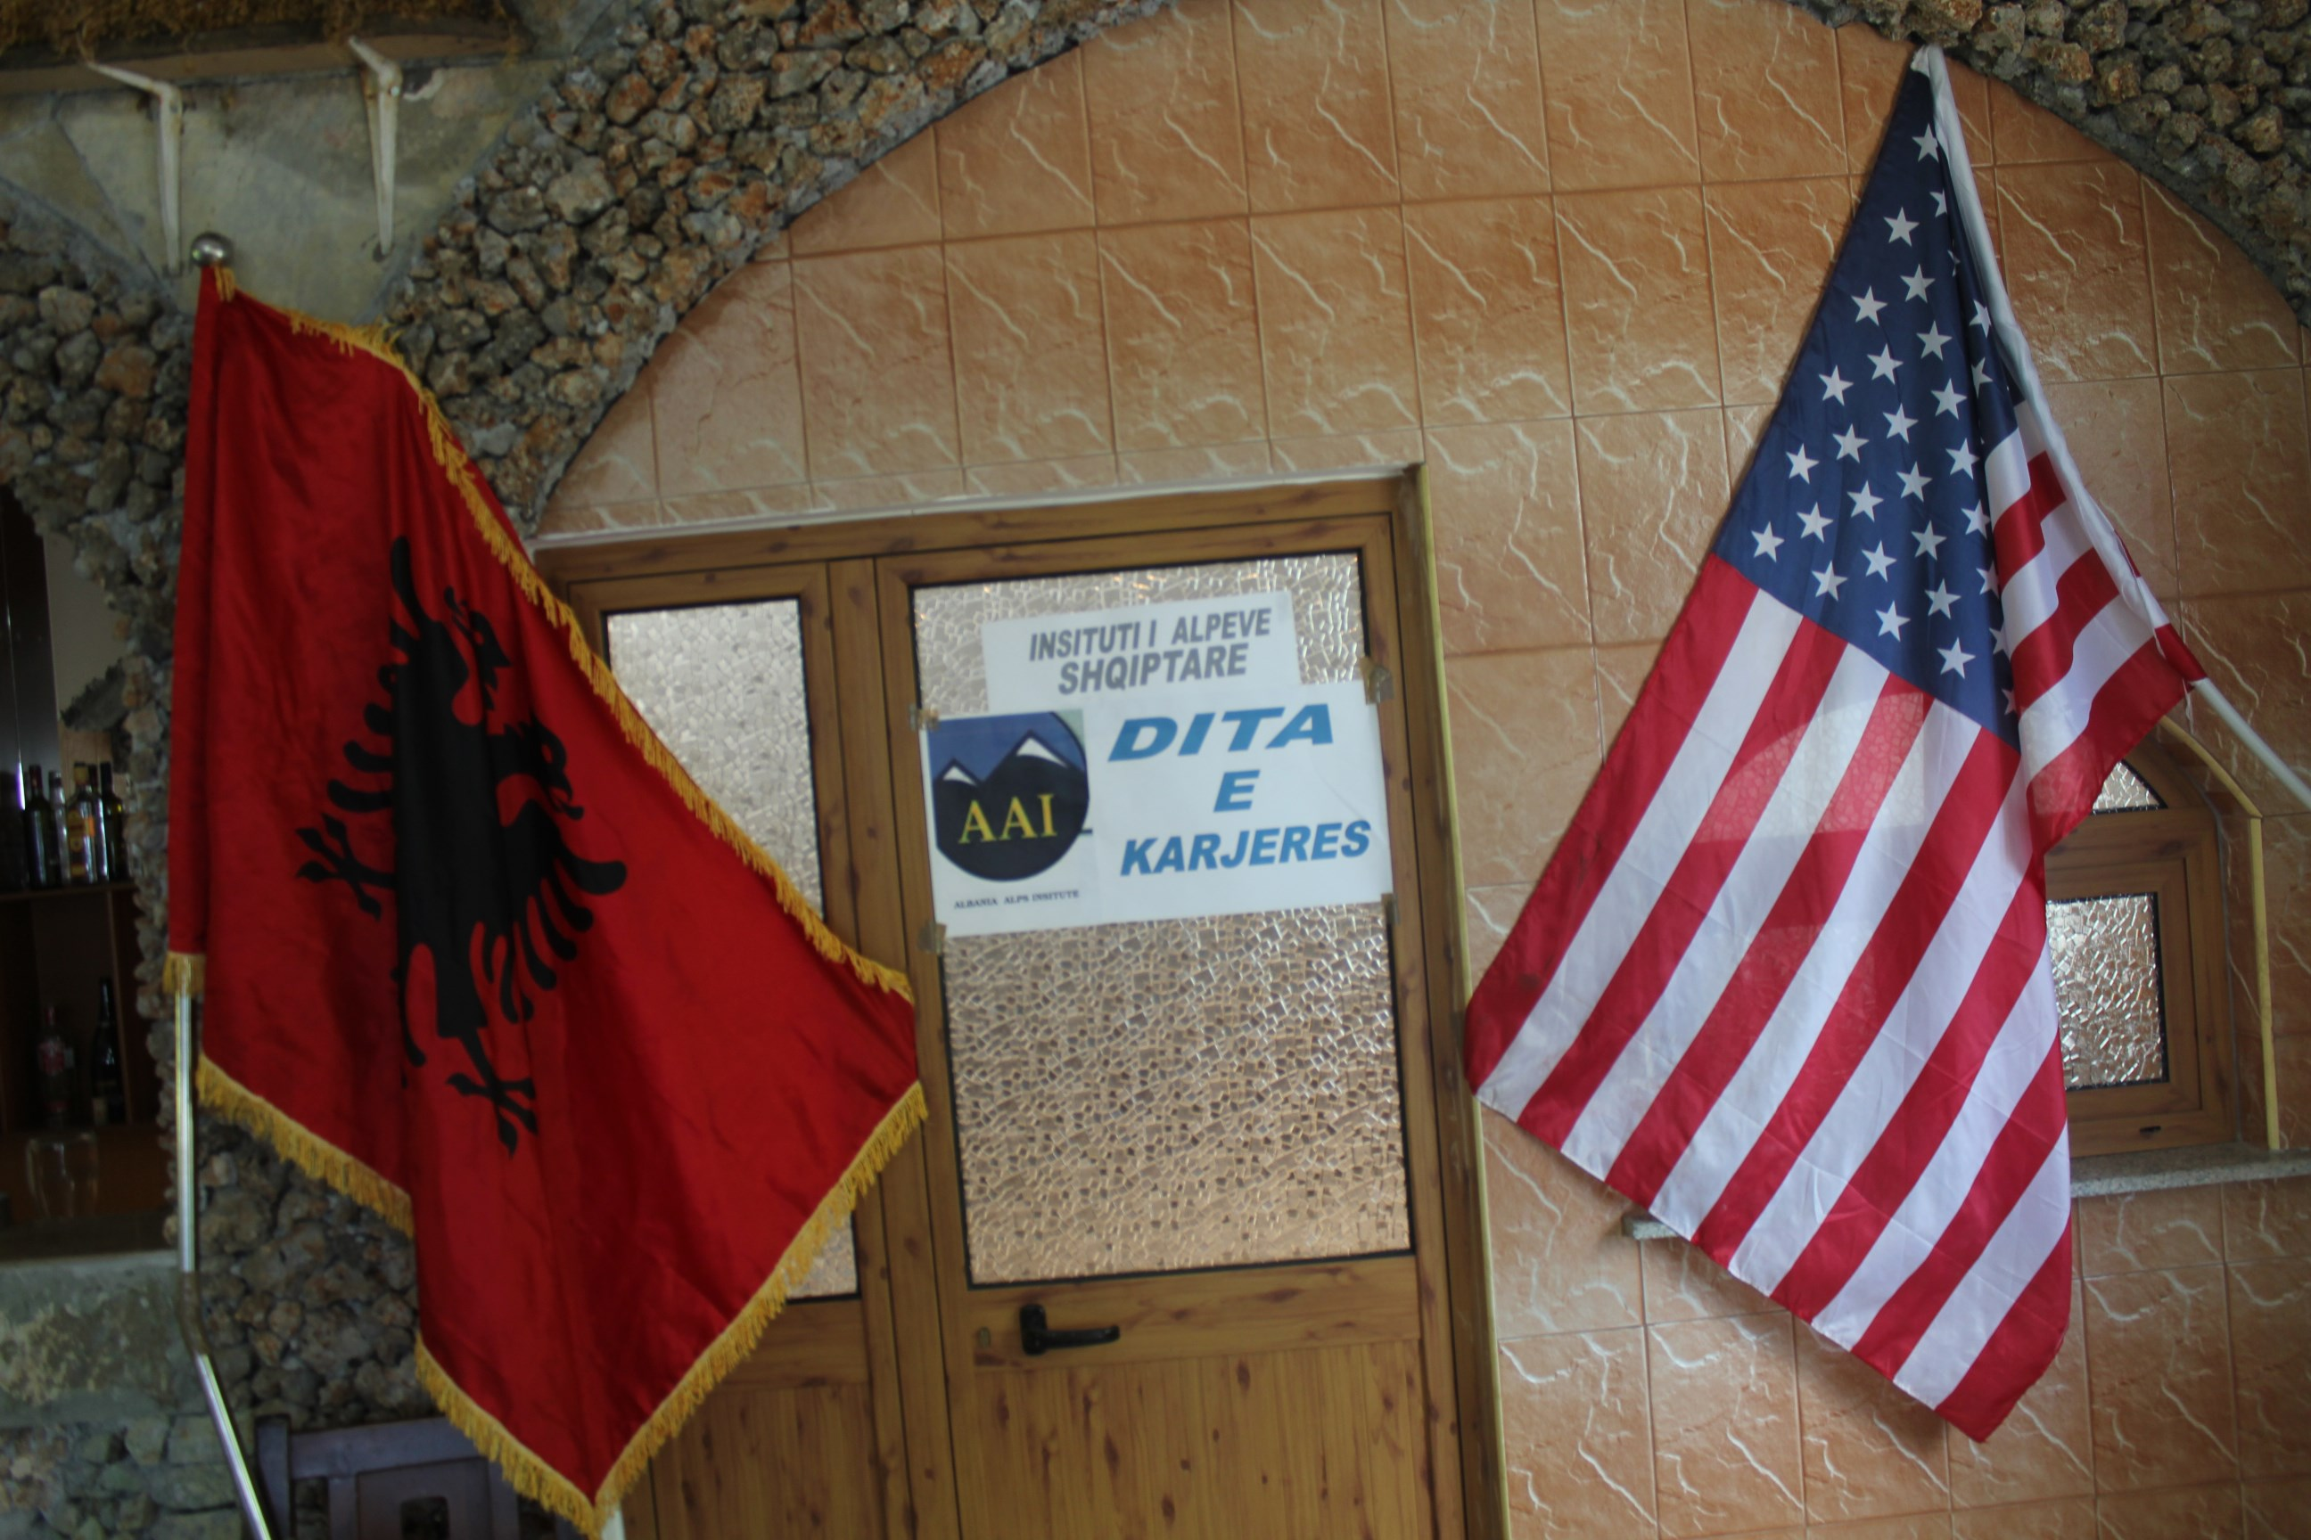
AAI Sponsored Career Day for High School and
University students.

Slide 32
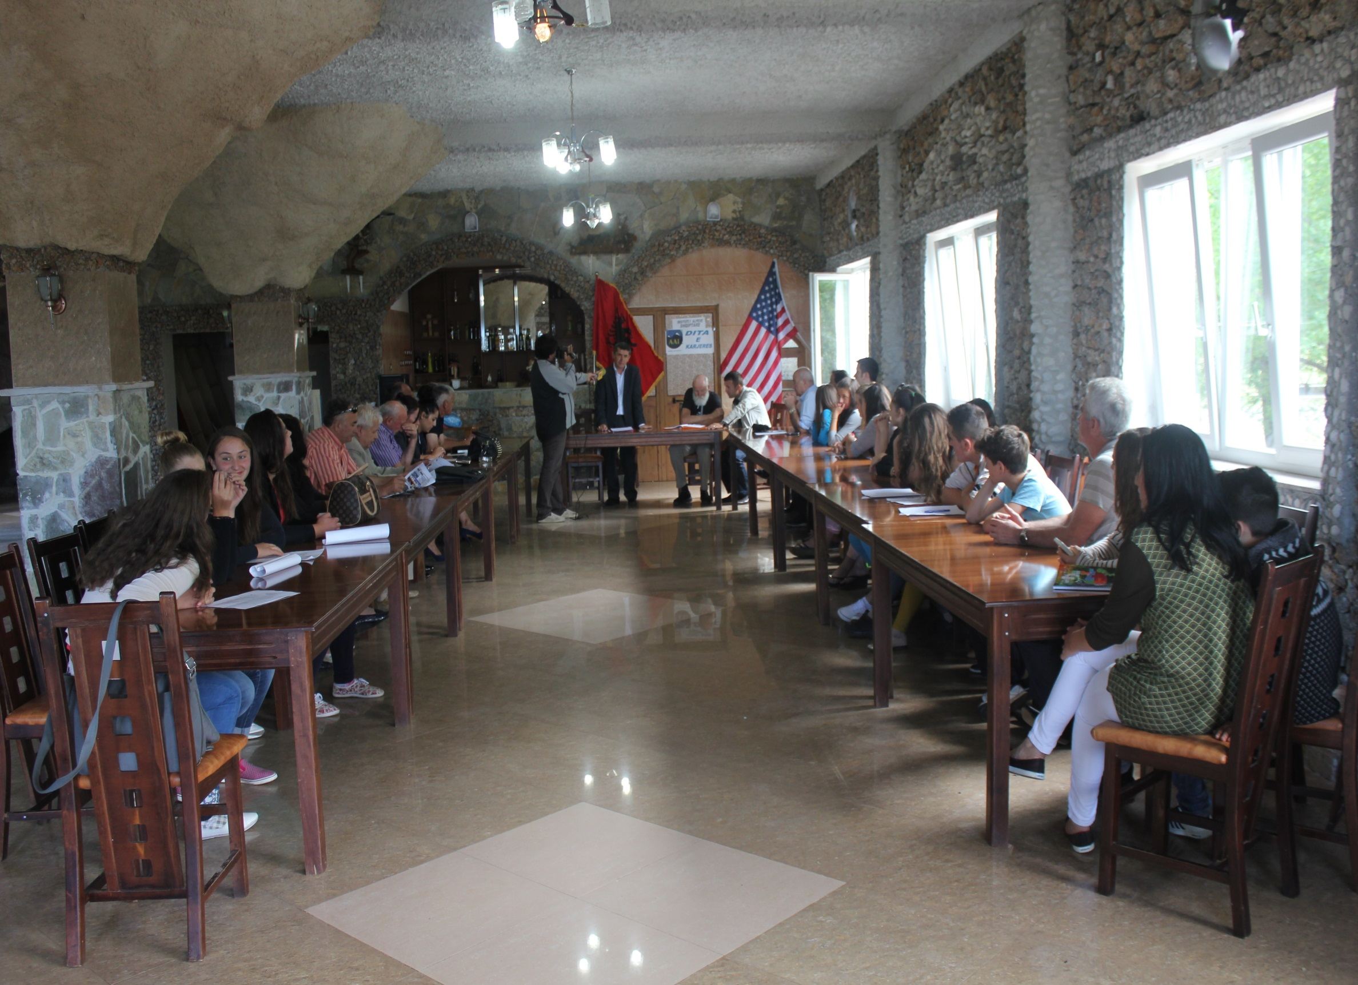

Slide 33
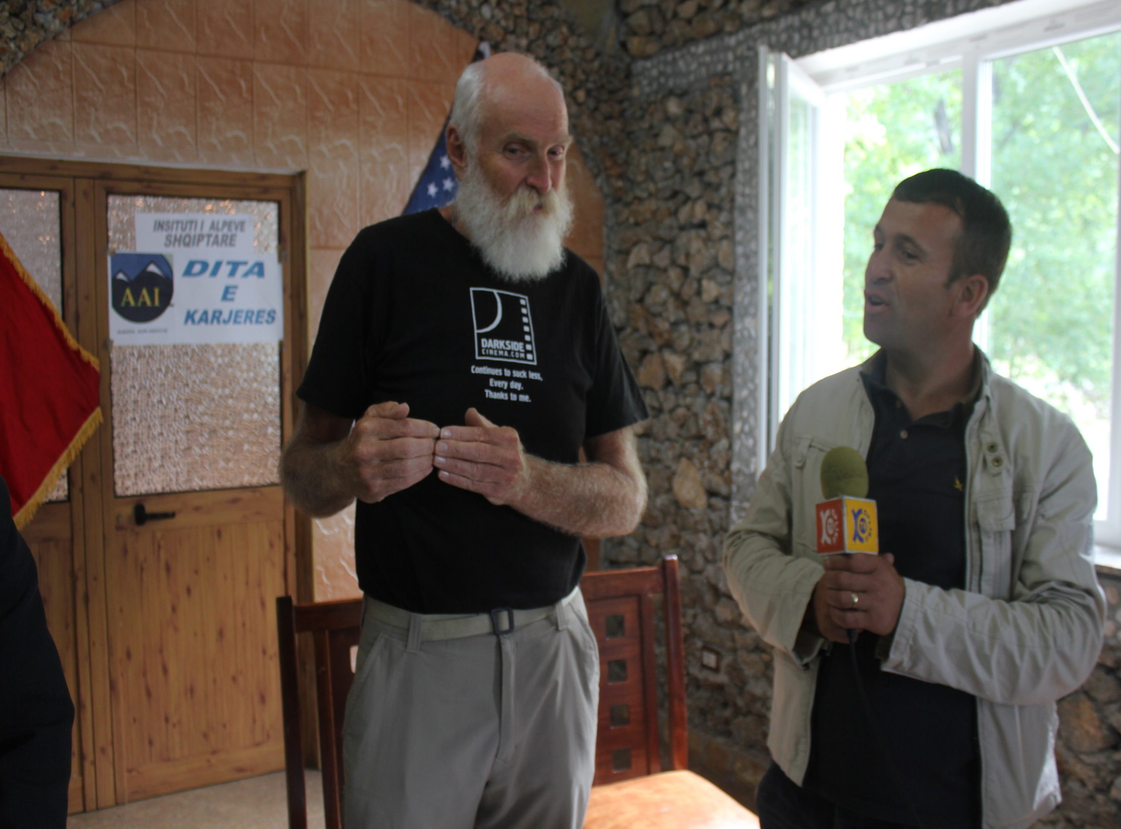
Steve’s intro, translated
by Aleks Vulaj, AAI
English teacher

Slide 34
Gjergj Rakaj, former Minister of Parliament center, speaking, with
Prof. Dr. Marash Rakaj, AAI Albania Manager on right.

Slide 35
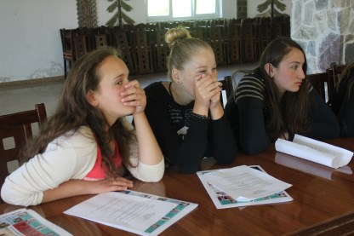

Slide 36
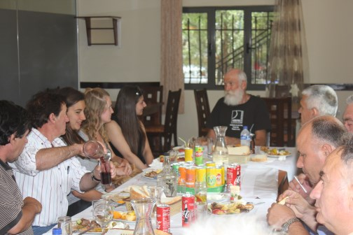
AAI sponsored dinner for all
speakers and students.

Slide 37
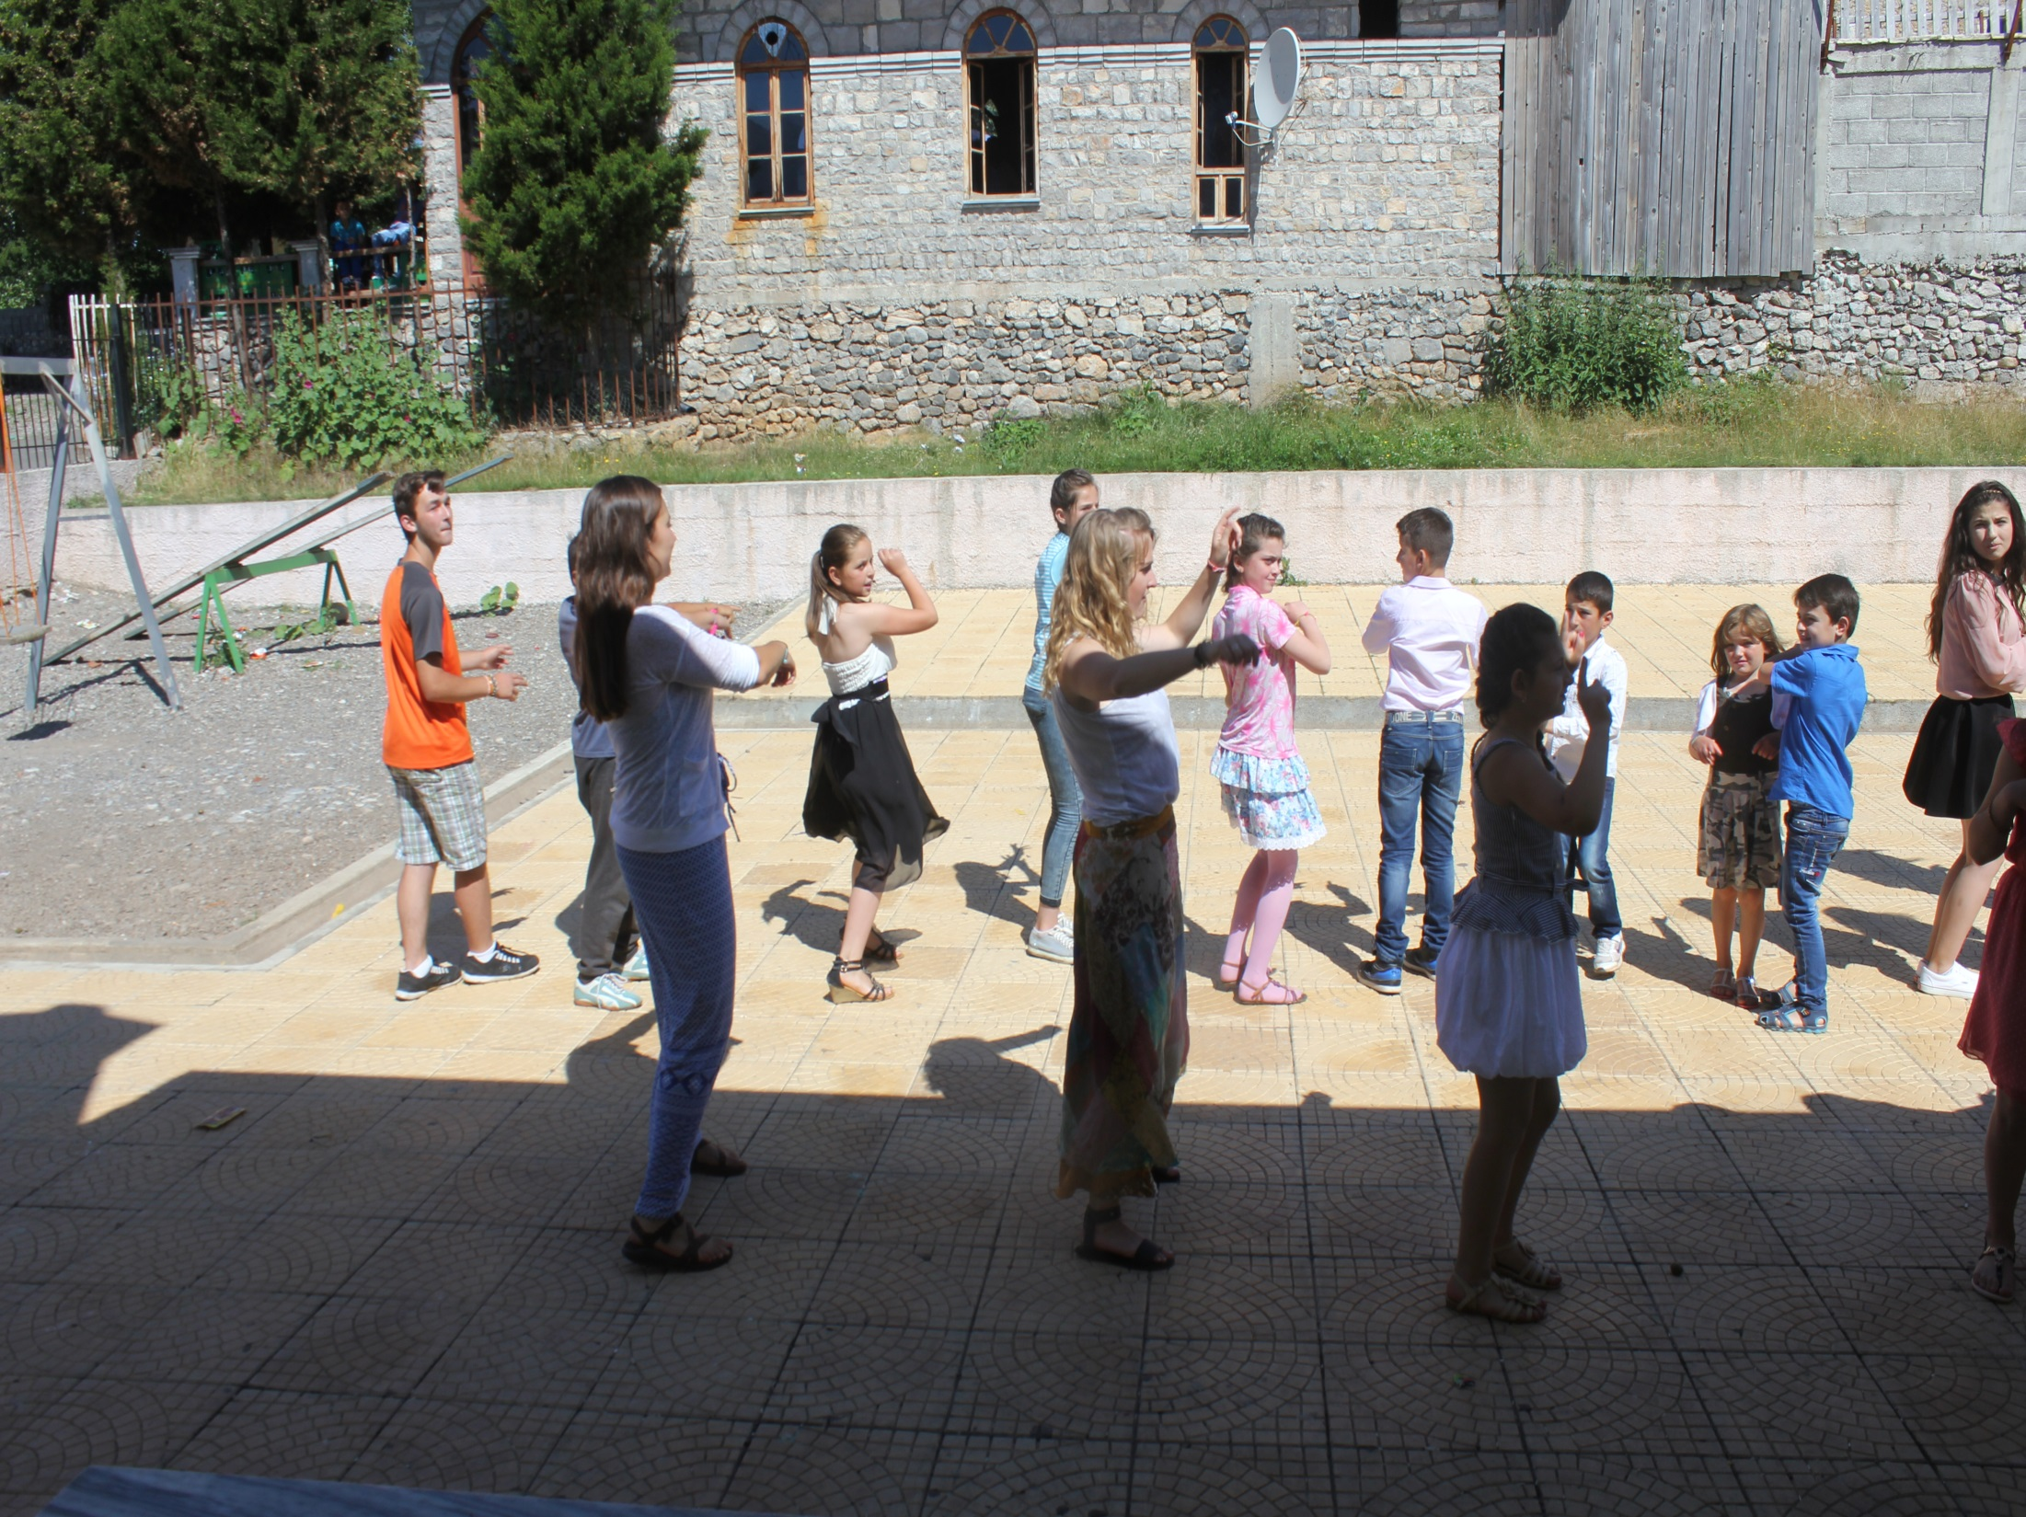
Adina Harri from Dartmouth College and Dana Lester from Oregon
State University, AAI 2015 volunteers teaching dance in Vrithe

Slide 38
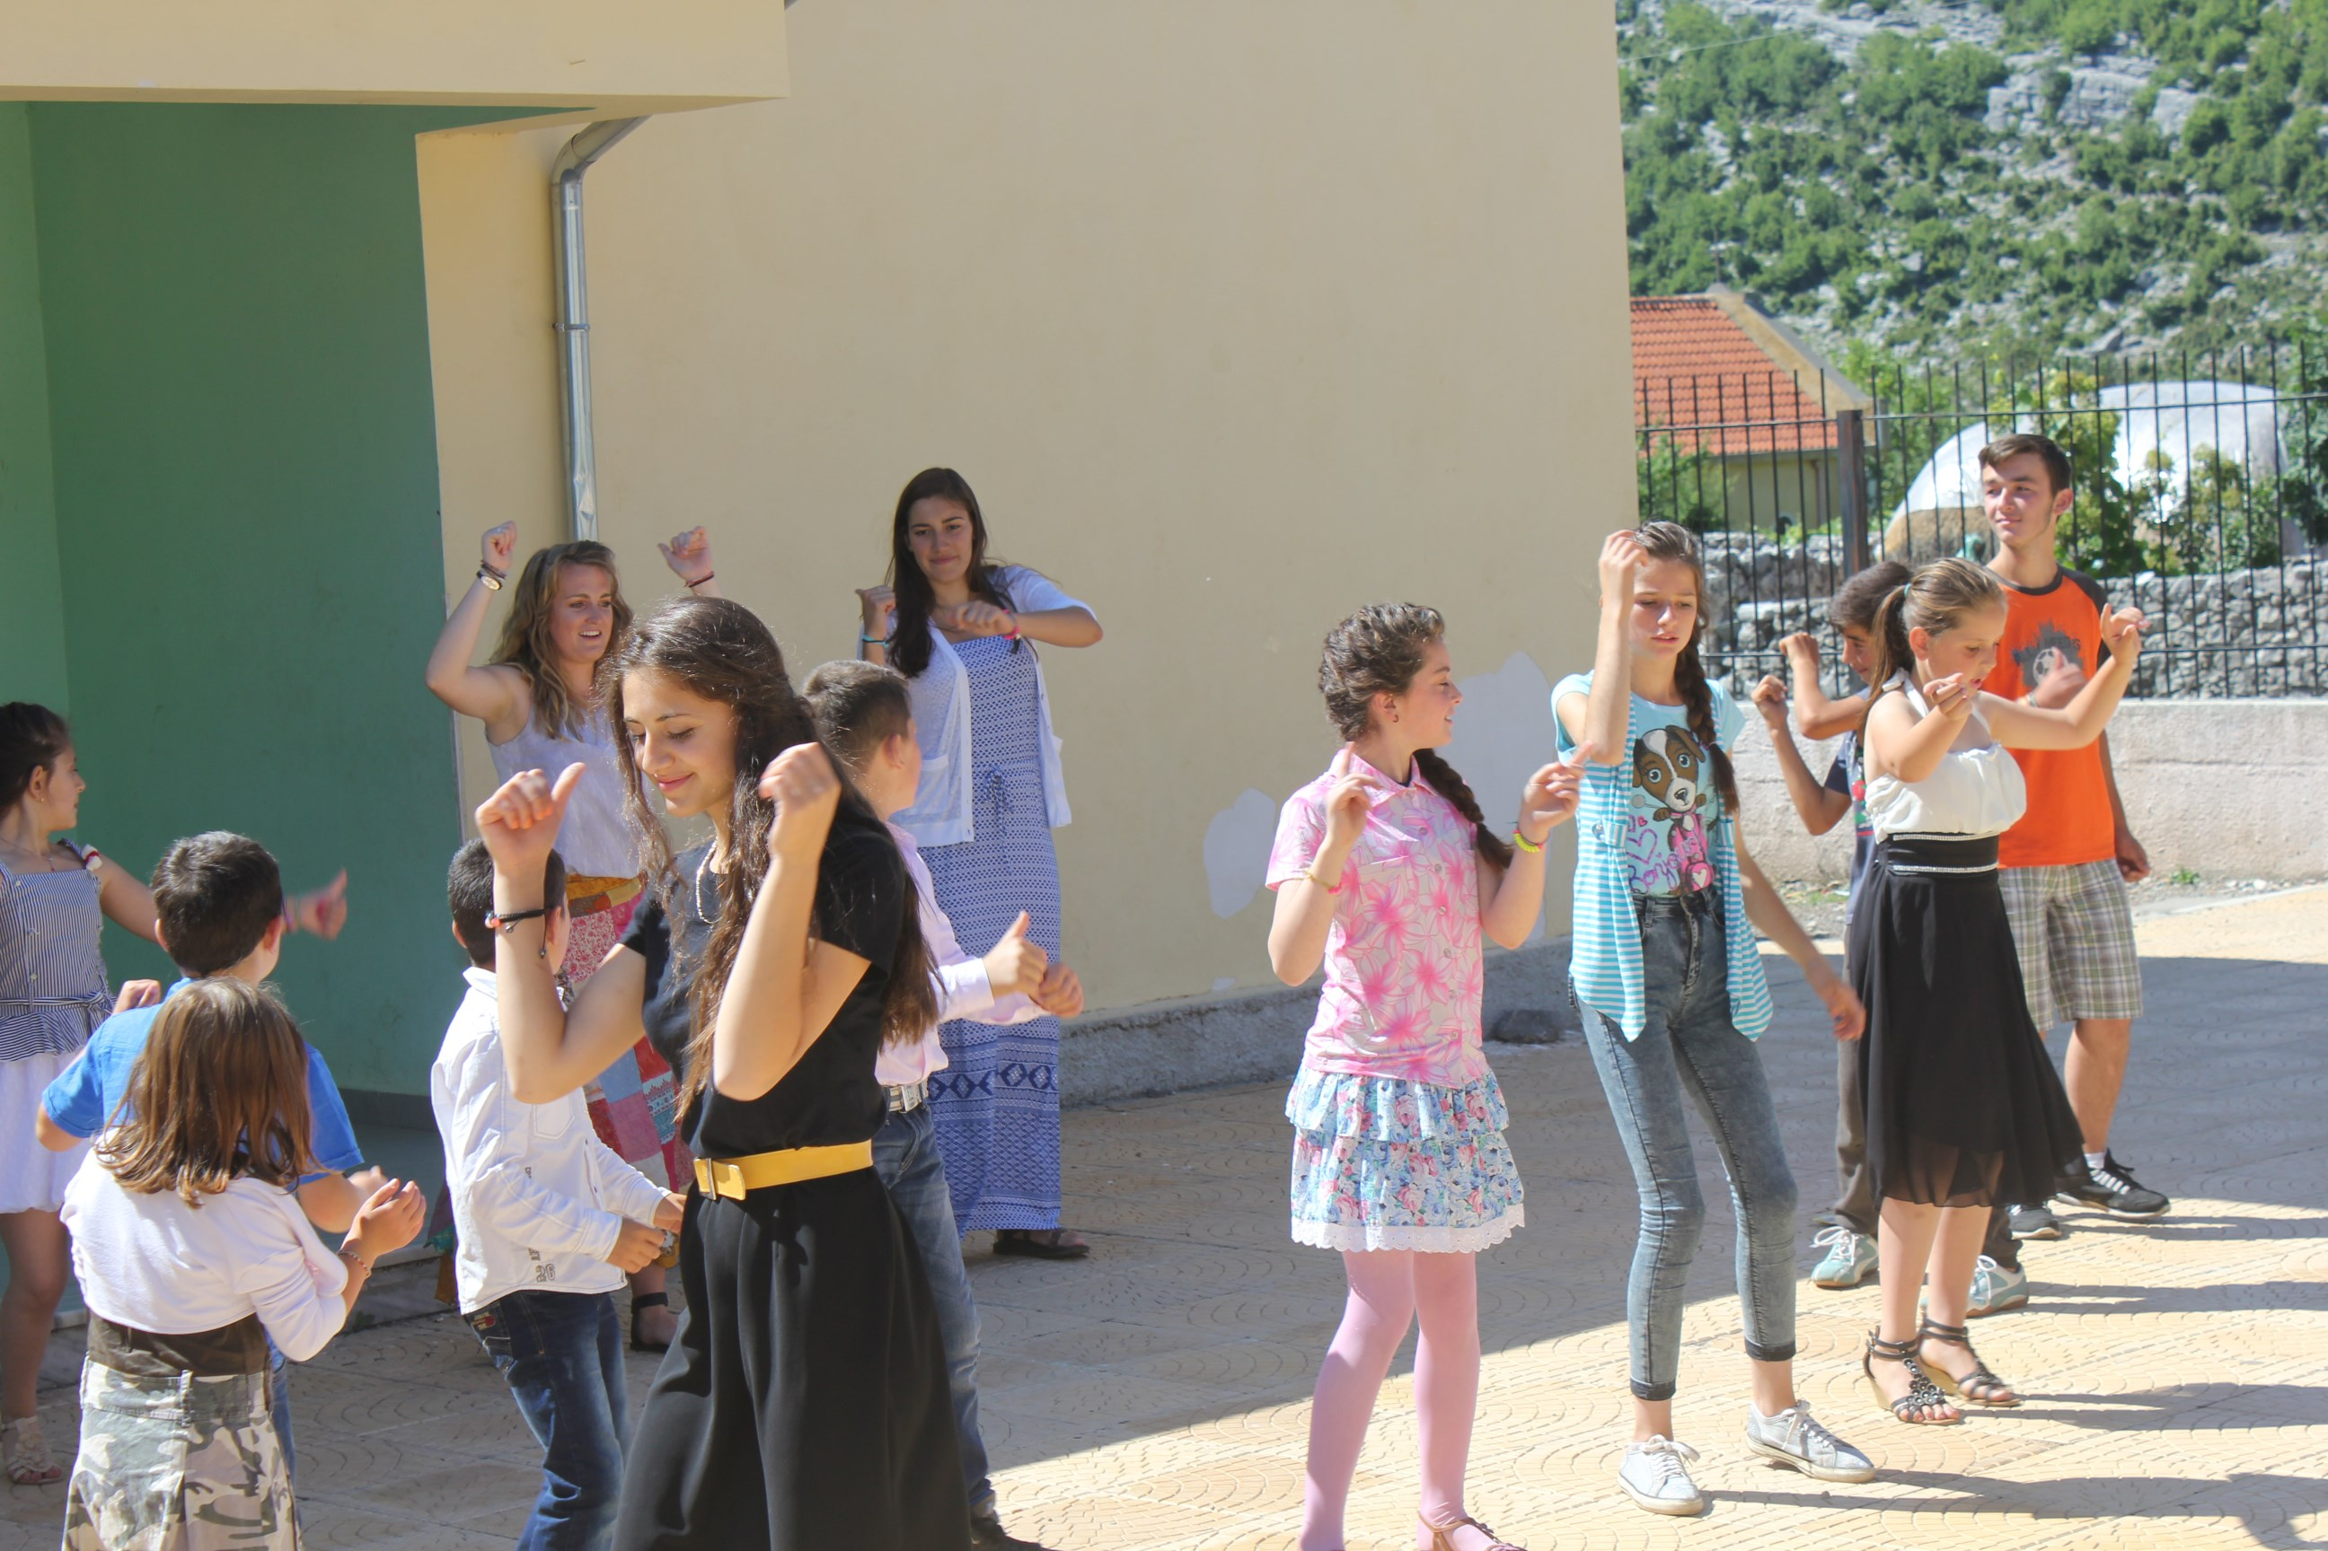

Slide 39
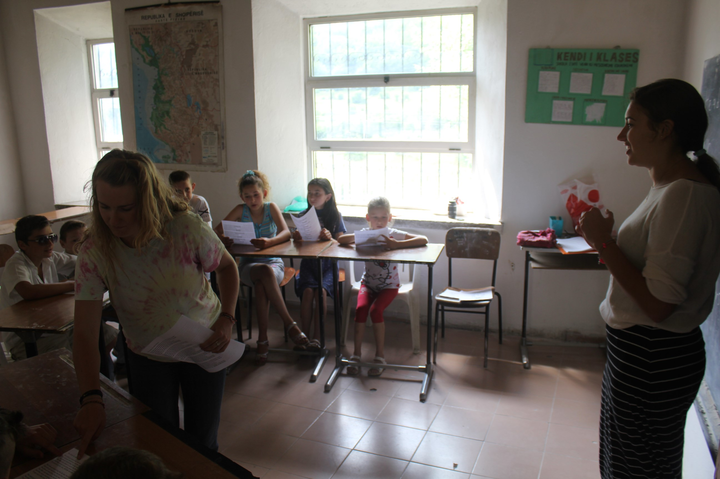
Teaching English in Boga

Slide 40
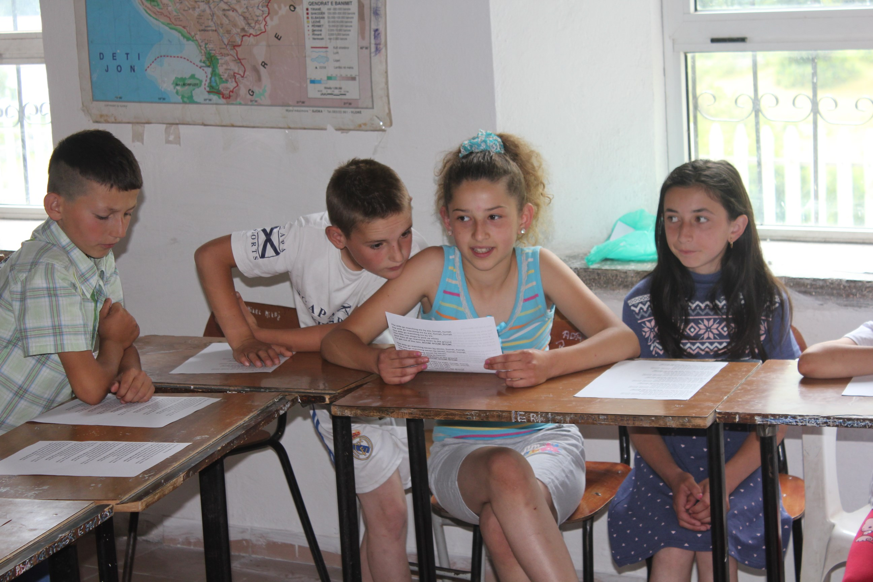

Slide 42
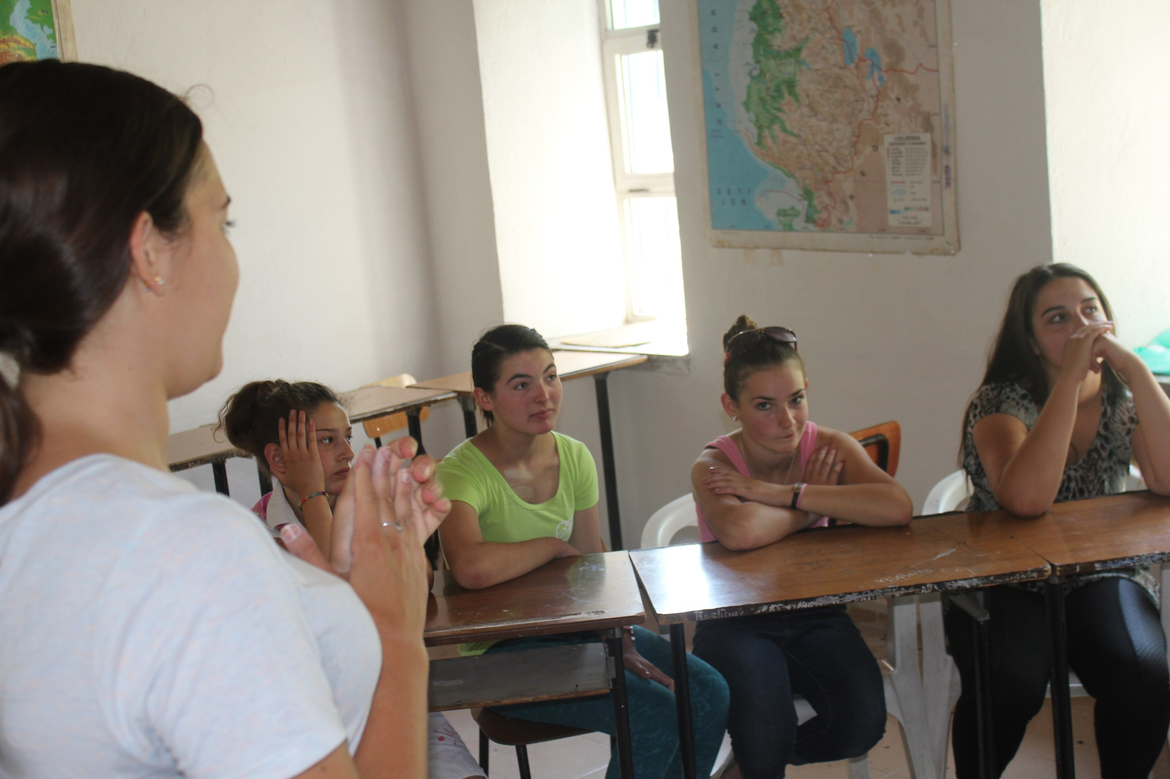

Slide 43
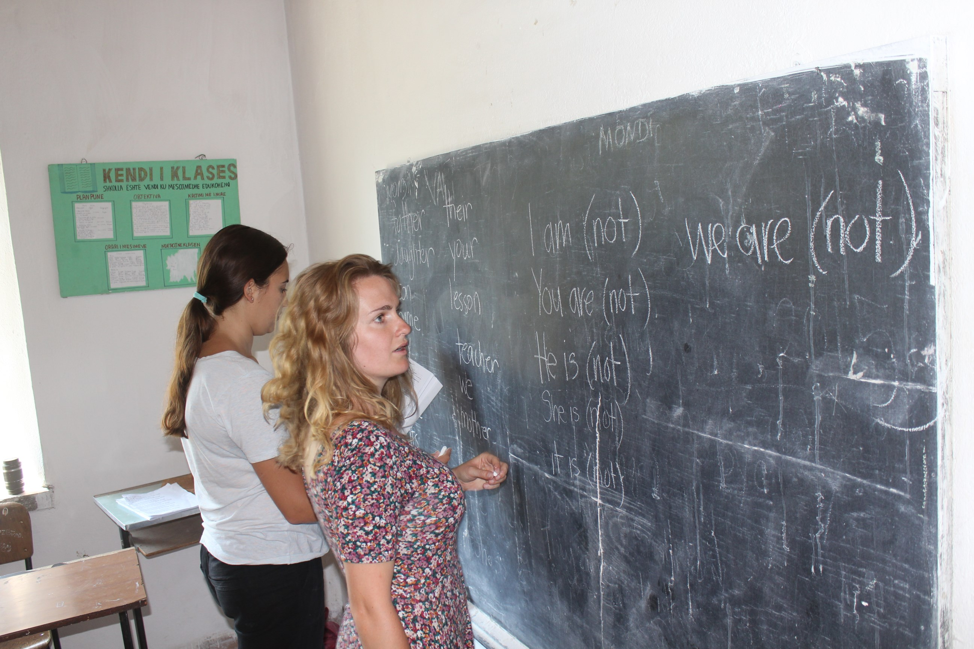

Slide 44
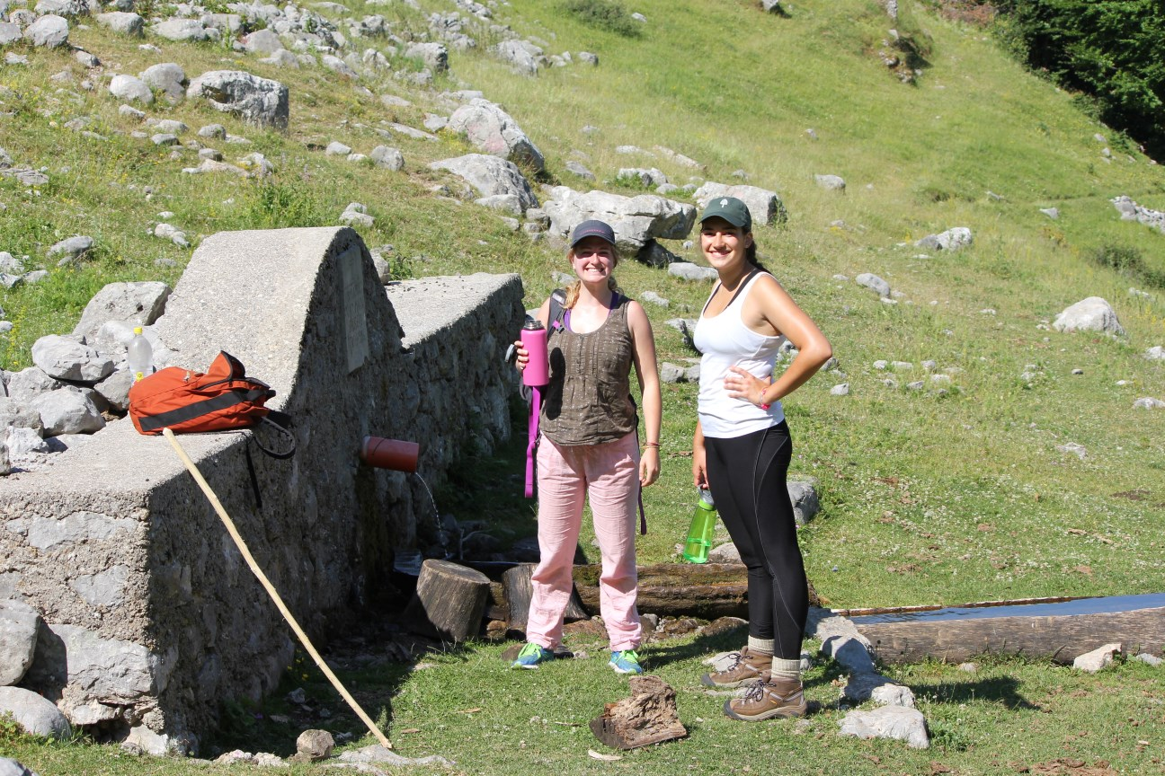
And hiking with Steve above Boga

Slide 45
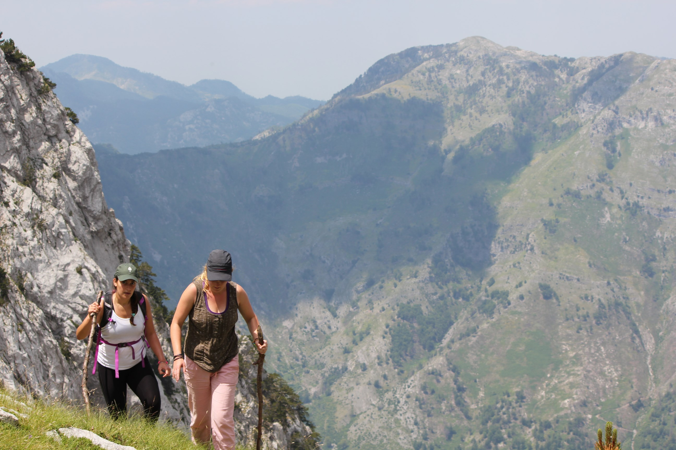

Slide 46
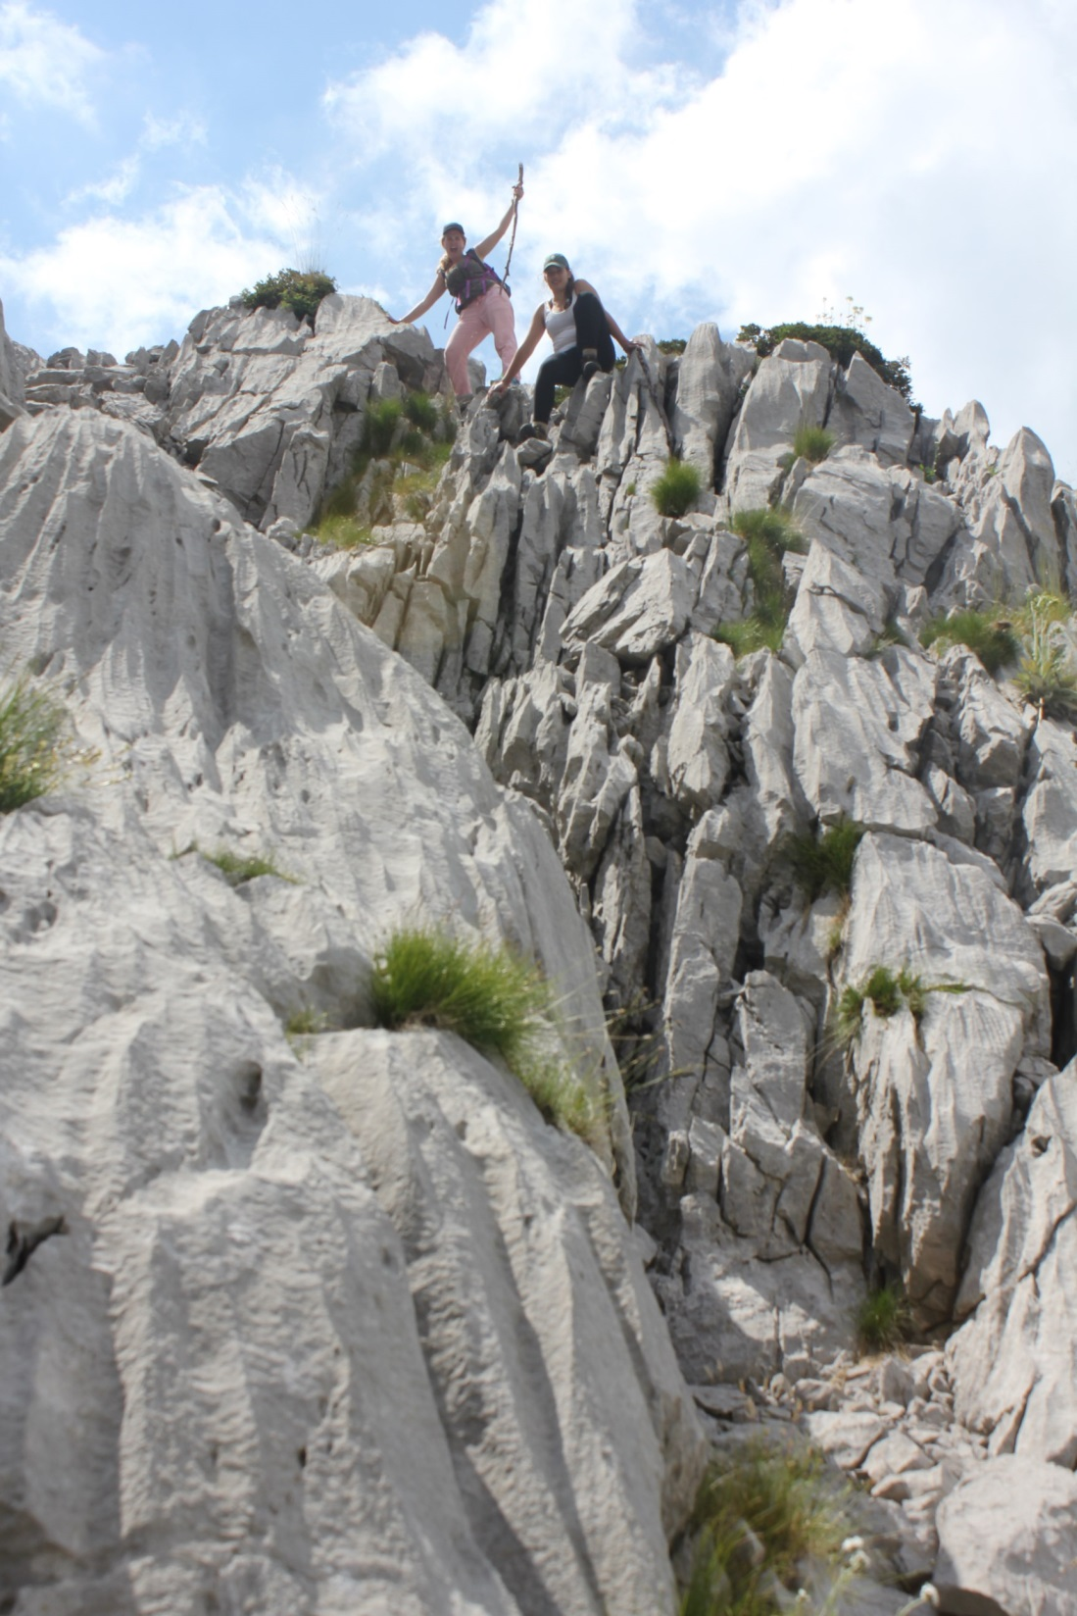

Slide 47
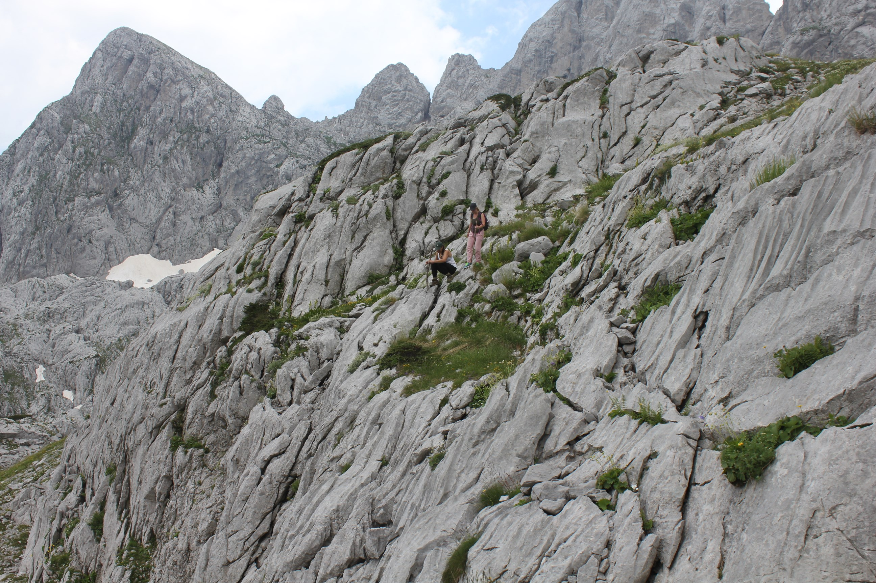

Slide 50
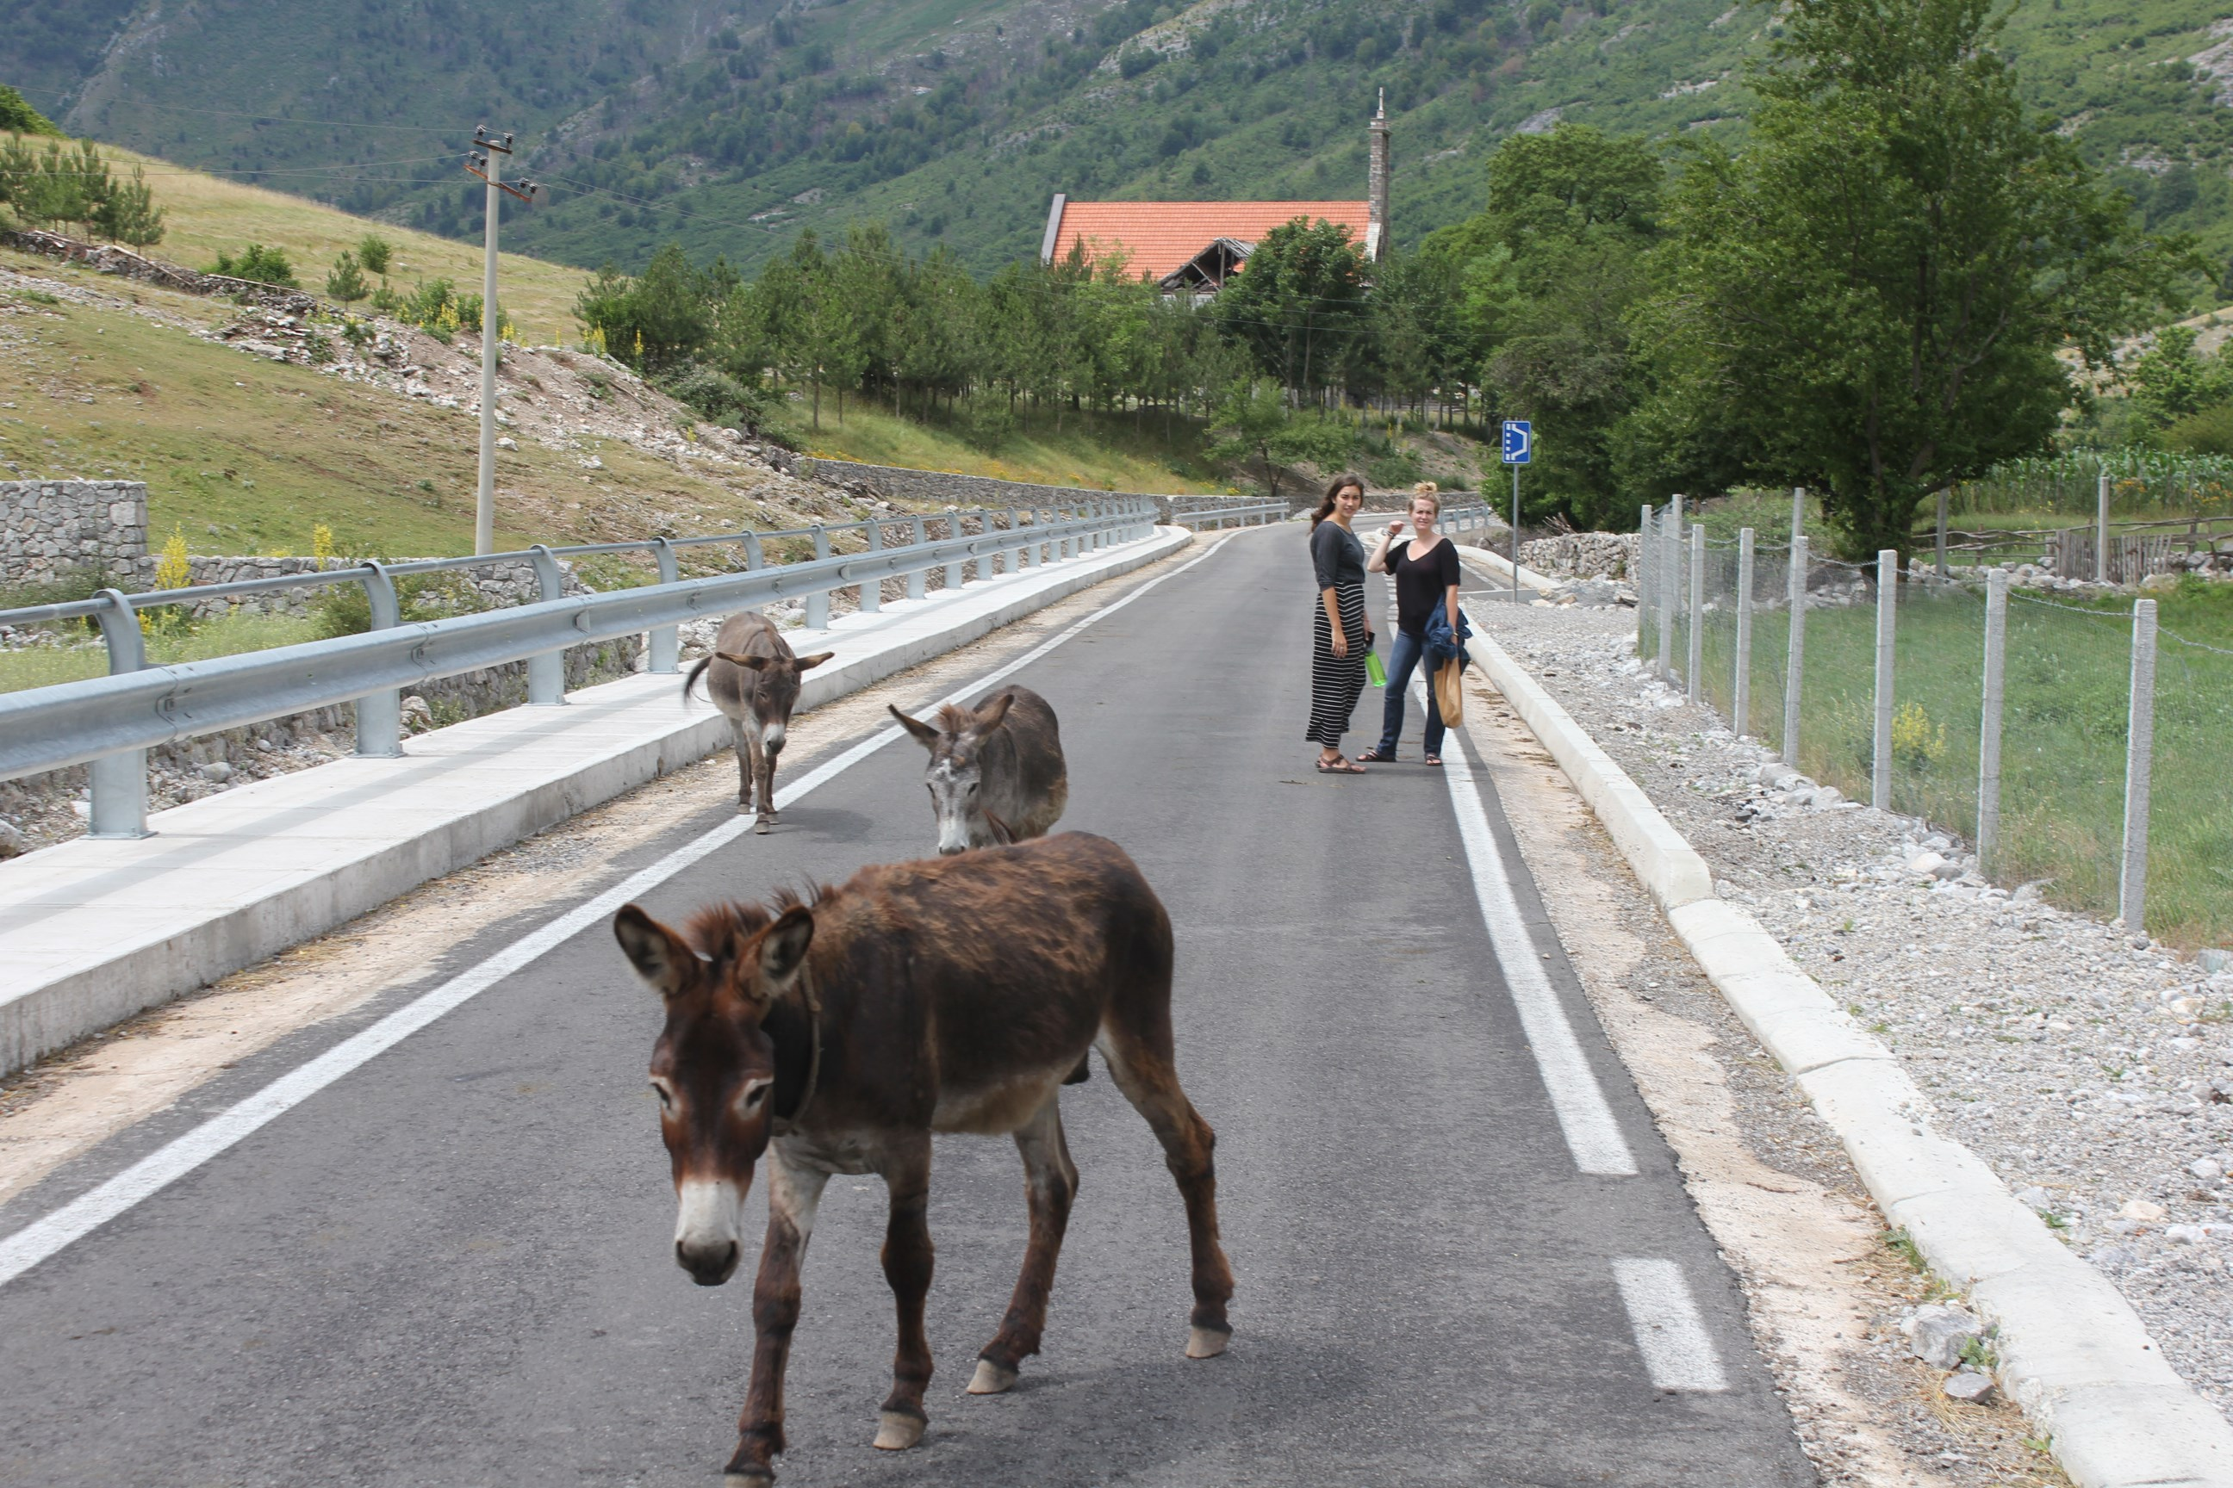
Adina, Dana, and friends on
the new road through Boga.

Slide 51
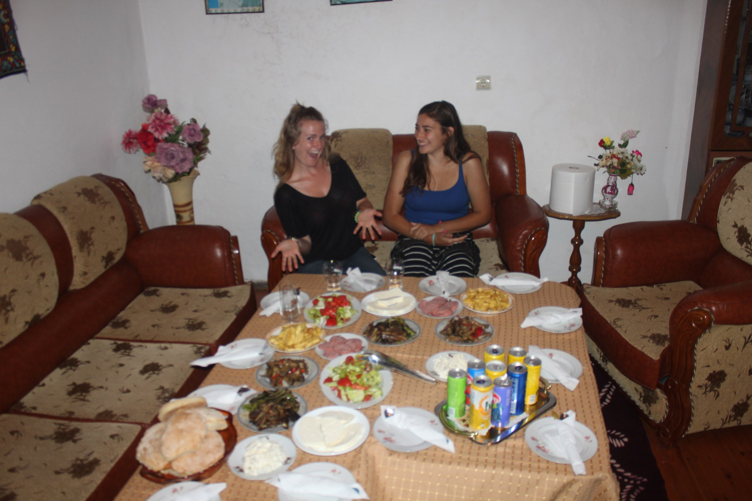
Farewell dinner at Ndue Milaj’s

Slide 52
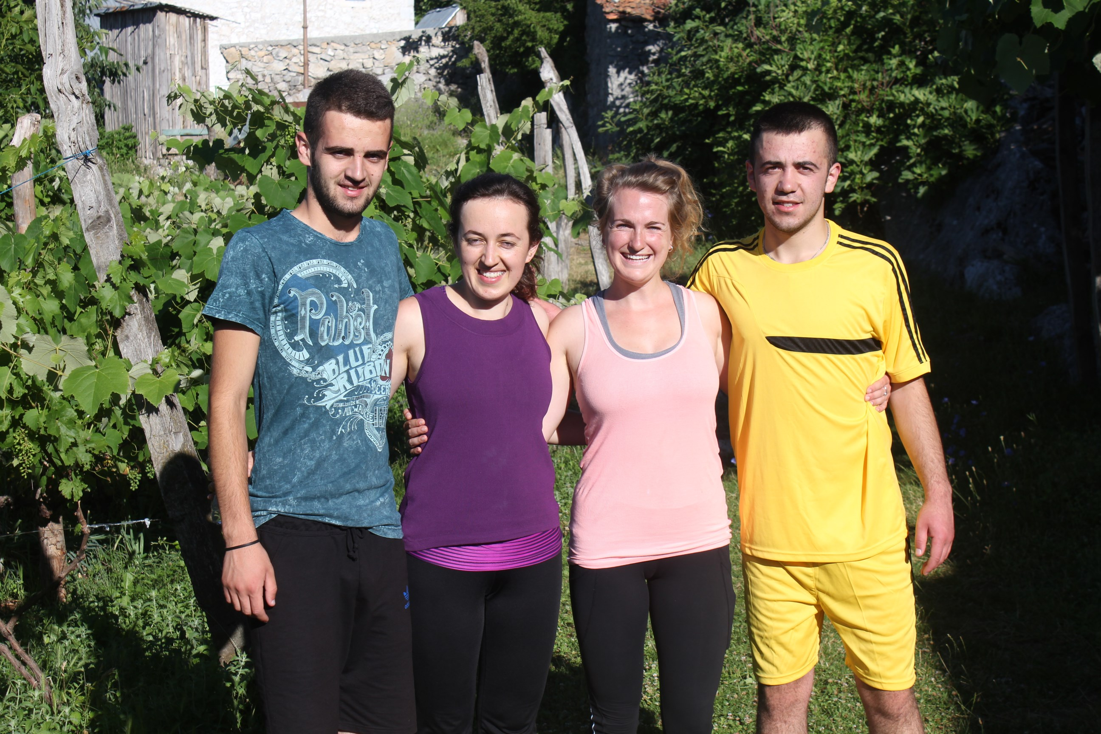
AAI Board Member, Kristina Milaj, volunteer Dana
Lester with Kristina’s brother Rob, and cousin Marjani

Slide 53
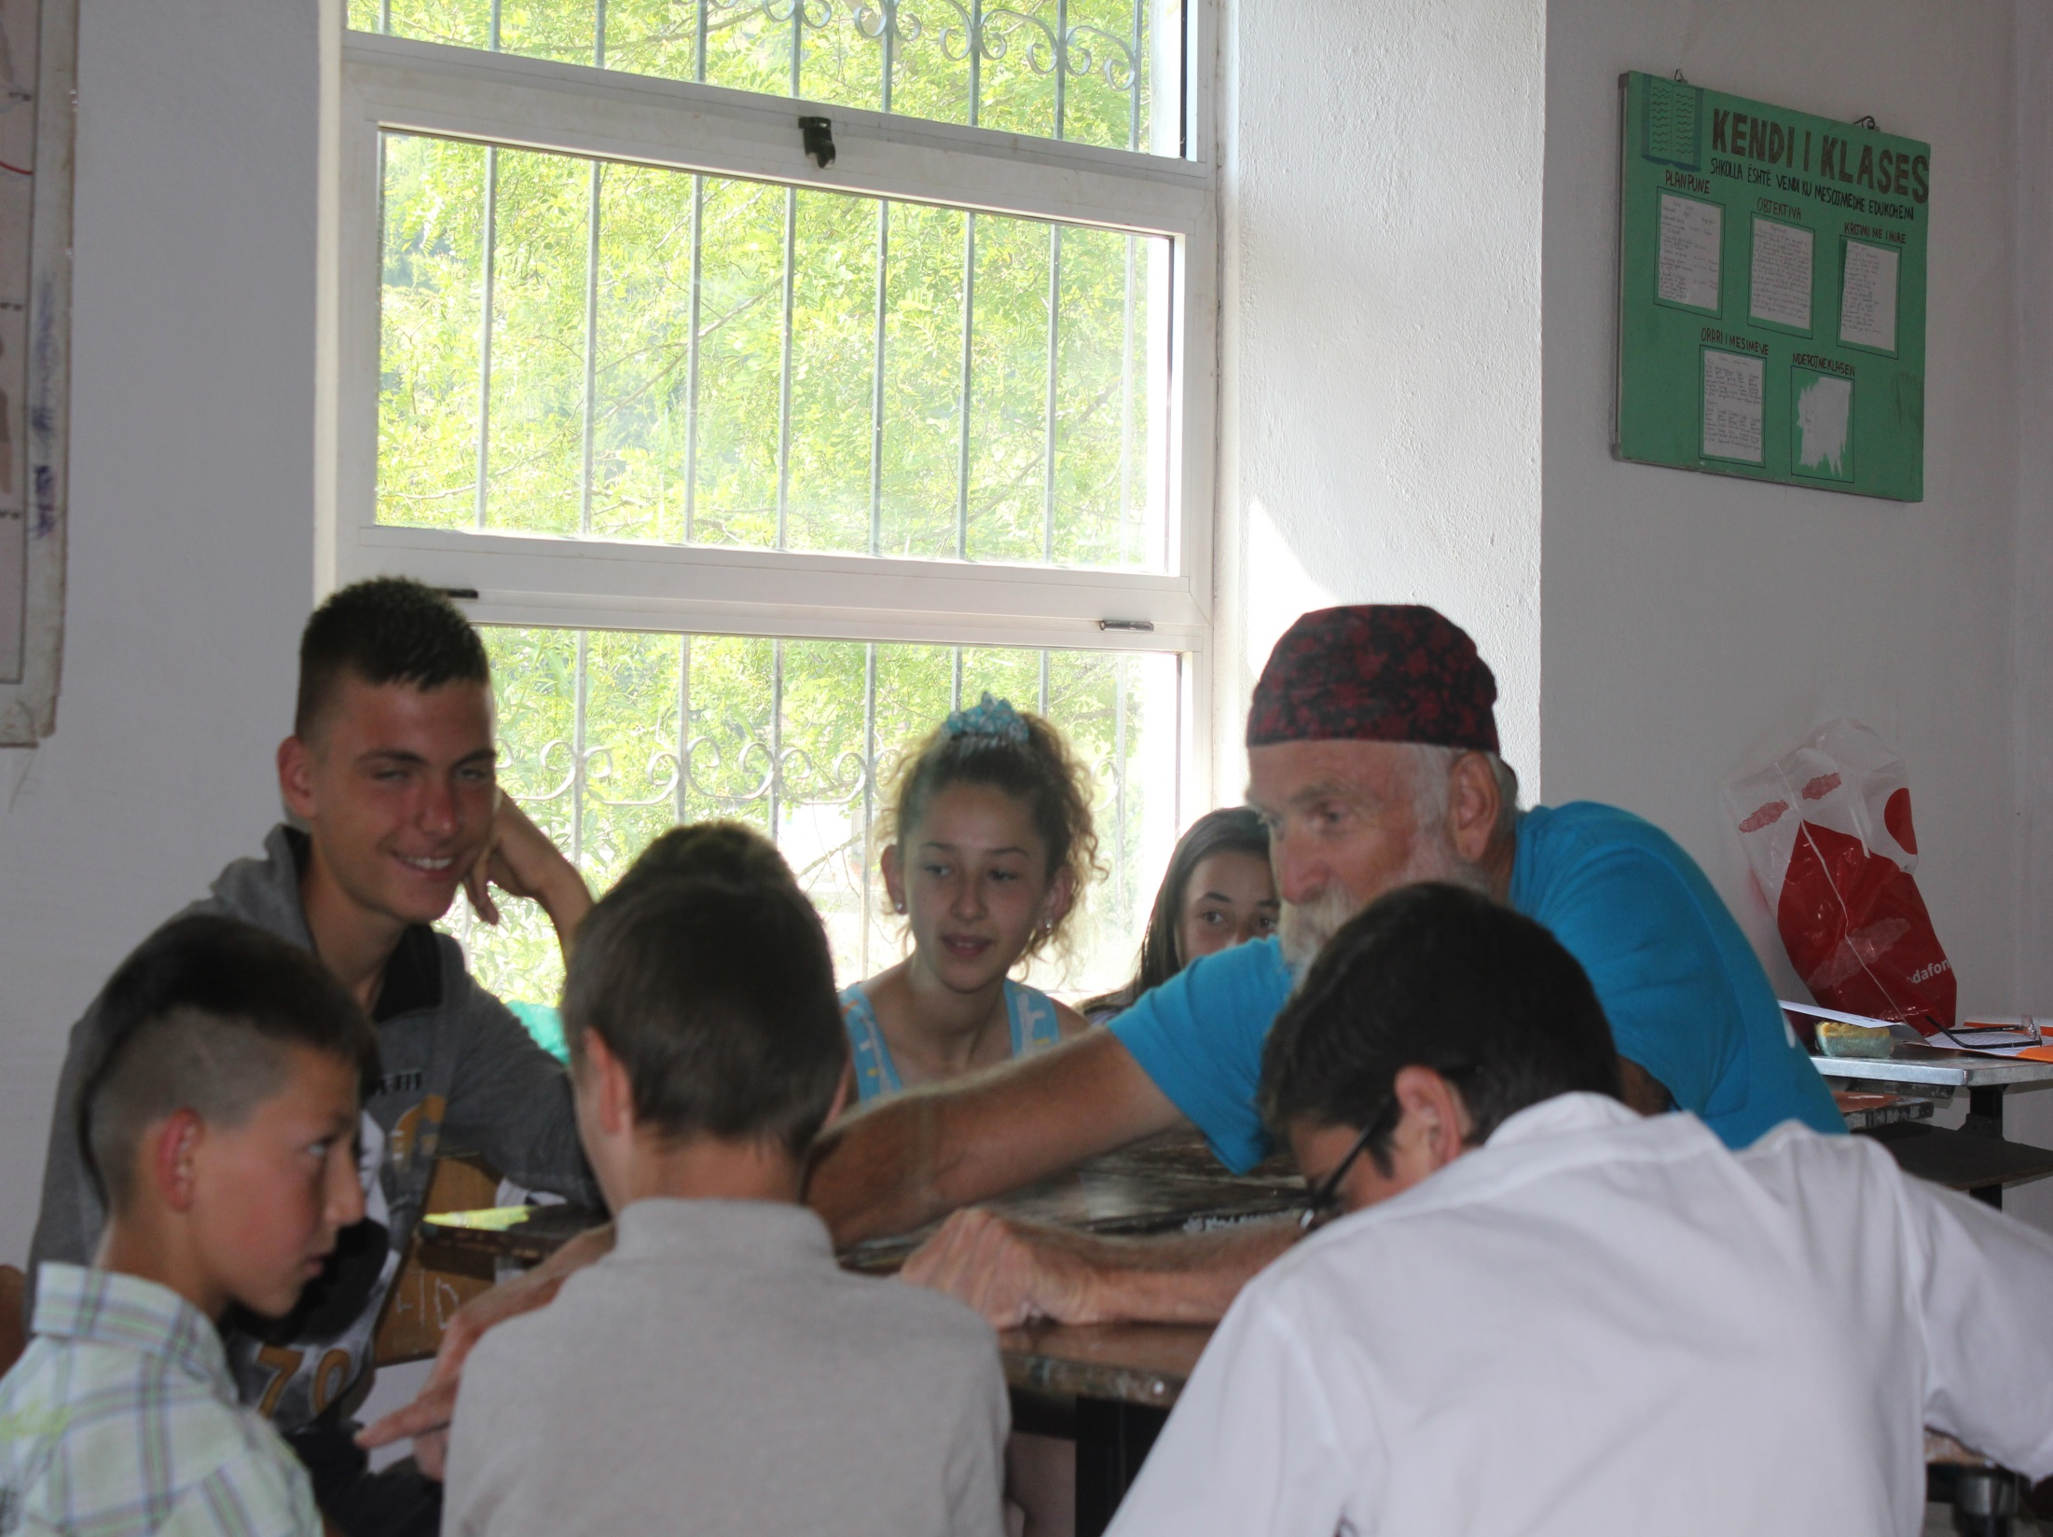
Steve teaching
English in Boga

Slide 54
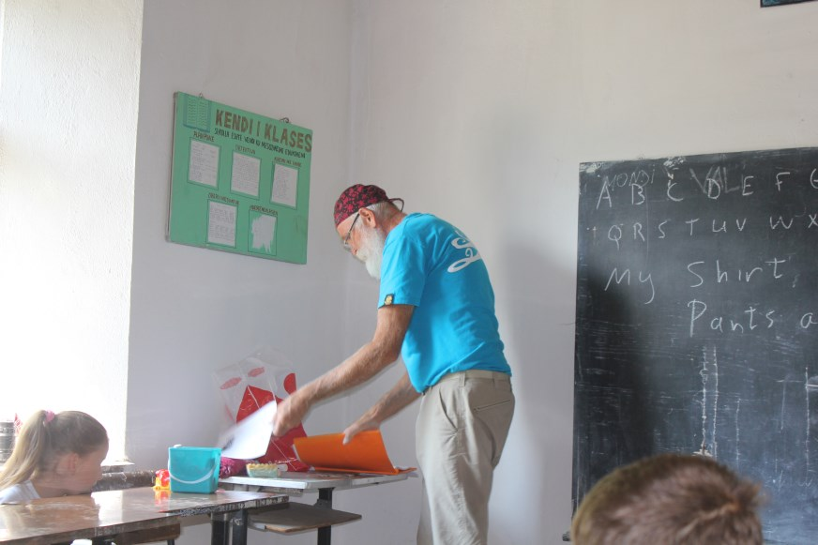

Slide 55
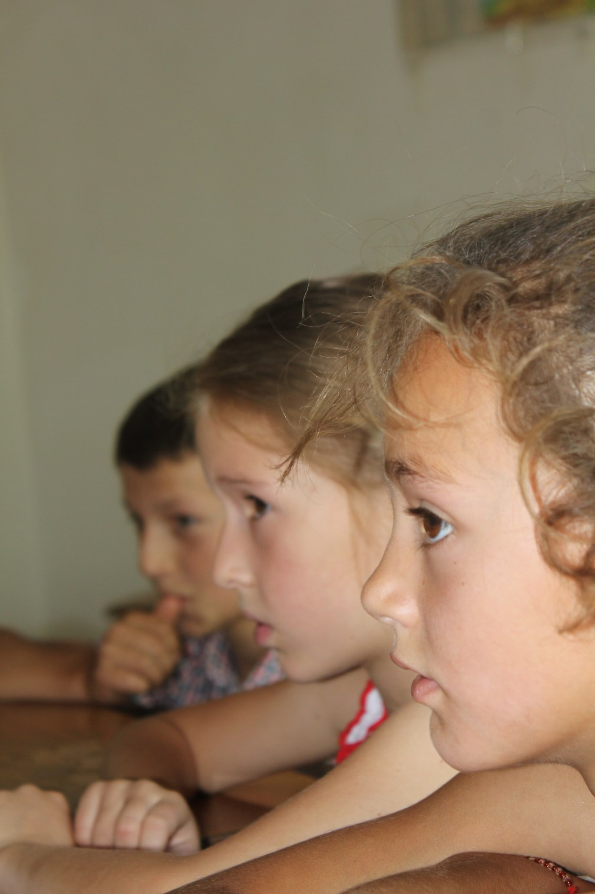
Intent!

Slide 56
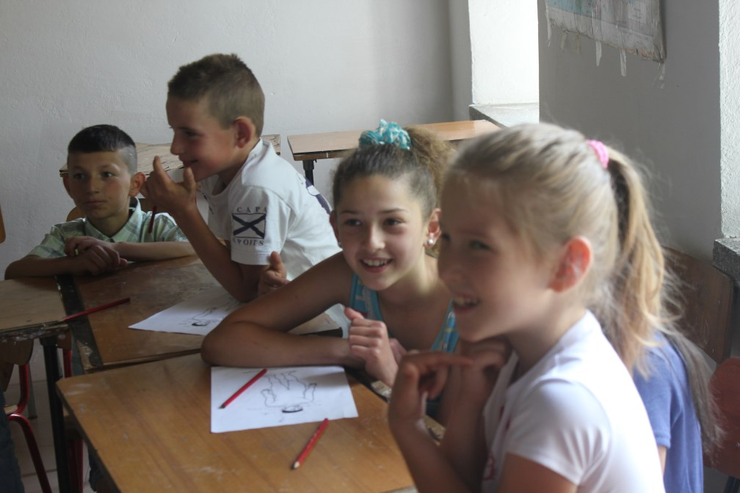

Slide 58
Marash and Steve with AAI Sponsored University Students
Clockwise—Marash, Steve, Ani Olaj, Toneta Durgaj, Dafina
Rakaj, Rregjina Rakaj, Brusilda Hoxhaj and Vitjola Colaj.
Kristina Milaj took the photo.

Slide 59
Support AAI programs
We provide books to five village libraries, support four
kindergartens, provide an English teacher, pay partial bus
fare for 35 students to travel to high school, and fund nine
university students. We also do some facility repairs.
We can only do this because people believe in what we
do and support us financially. See our website:
http://www.albanianalps.org to find out how to donate.
AAI is a 501c-3 corporation and all donations are tax deductible.

